Slide 1
Epigenetic differences between CD8 populations in T1D patients
5-23-24 SI meeting
Ty Bottorff – Bioinformatics postdoc
Linsley lab
Notes:
P576-1 - ITN ATAC study - Better defining T_{ex} in teplizumab-treated subjects to inform combination treatments
Teplizumab: humanized anti-CD3 monoclonal Ab to delay onset of stage 3 T1D in people with stage 2 T1D. mechanism: weak agonist of TCR-CD3 to induce anergy/apoptosis of T cells (i.e. autoreactive Teffs I presume)
ATACseq relies on transposase that cuts and adds seq adaptors, prefers accessible chromatin

Slide 2
Outline
Background on T_{ex} and T1D
Brief QC
Preliminary results

Slide 3
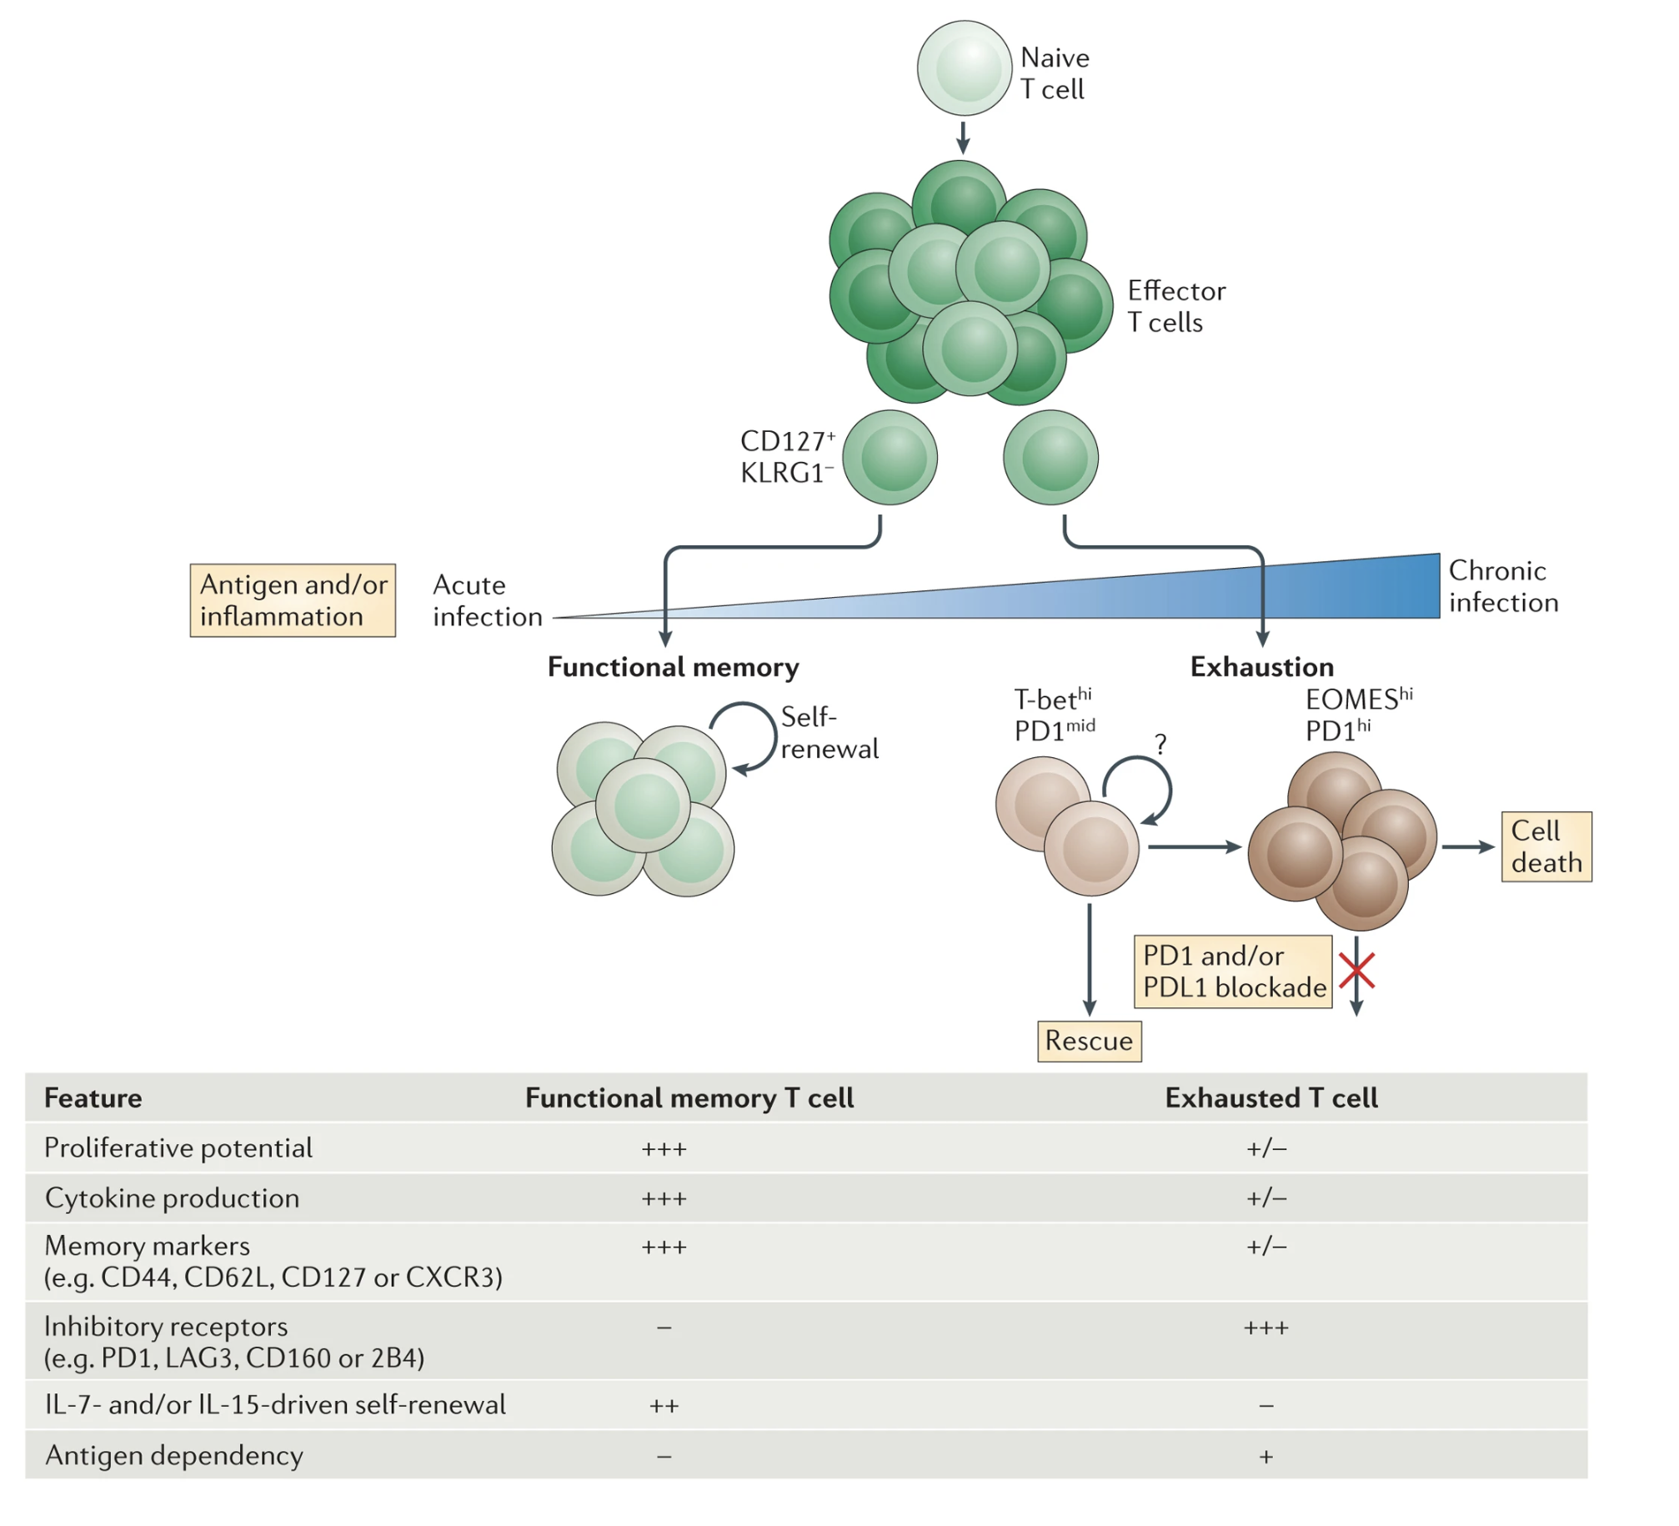
T cell exhaustion results from chronic antigen stimulation, inability to fully clear antigen
IRs (TIGIT, PD1) and specific TFs (EOMES, TOX) expressed
Wherry & Kurachi. Nat Reviews Immunol. 2015
Notes:
Tex cells lack open chromatin sites in *Ifng* locus in Teff/TEM cells, Tex cells have open chromatin sites in *Pdcd1* locus (PD1), i.e. Teff down IR up it tracks
This green is non-exhausted CD127+
Autoimmunity still results likely because affinity between antigens and TCRs are low, so T cells don’t become overly exhausted (i.e. higher affinity TCR-neoantigens more strongly stimulate T cells and exhausts them)
With weakly stimulated but chronic antigens, T cells don’t exhaust (i.e. autoimmunity)
So in case of autoimmunity this is great, in case of cancer it associates with worse response
3 signal model for exhaustion: persistent antigen exposure, negative costimulatory signals, chronic inflammation
Evolutionary reason for Tex could be to minimize self-tissue damage with still controlling antigen somewhat
More and more exhaustion leads to terminal exhaustion & apoptosis

Slide 4
Levels of T_{ex} are a biomarker in T1D
Higher levels of T_{ex} (TIGIT⁺ KLRG1⁺) CD8s associated with
slower progression to T1D
teplizumab and alefacept responses
beneficial response to therapy in at risk for and new onset T1D
Higher levels of TIGIT⁺KLRG1⁺CD127⁺ CD8s associated with worse outcome
Phenotype of islet-reactive CD8s is more so T_{eff}, less so T_{ex}
Figure 2. Individuals with high levels of different Tex subsets vary in their clinical outcomes after teplizumab treatment. We stratified teplizumab- treated (Active) subjects from the TN-10 study having high (above third quartile) or low (below third quartile) levels of the indicated Tex subsets at 3 months post-treatment. We then used Kaplan-Meier survival analysis to compare time to T1D progression for these groups. As a negative control, we used as placebo- treated subjects.
Notes:
Teplizumab: first FDA approved therapeutic for T1D therapy!
3 signal model for exhaustion: persistent antigen exposure, negative costimulatory signals, chronic inflammation
TEX are heterogeneous, with some TEX associating with better or worse outcome in cancer/chronic infection! So not always positive correlation b/w Tex and intensity of autoimmunity?
TIGIT+KLRG1+ only partially exhausted, ie there are more exhaustion markers

Slide 5
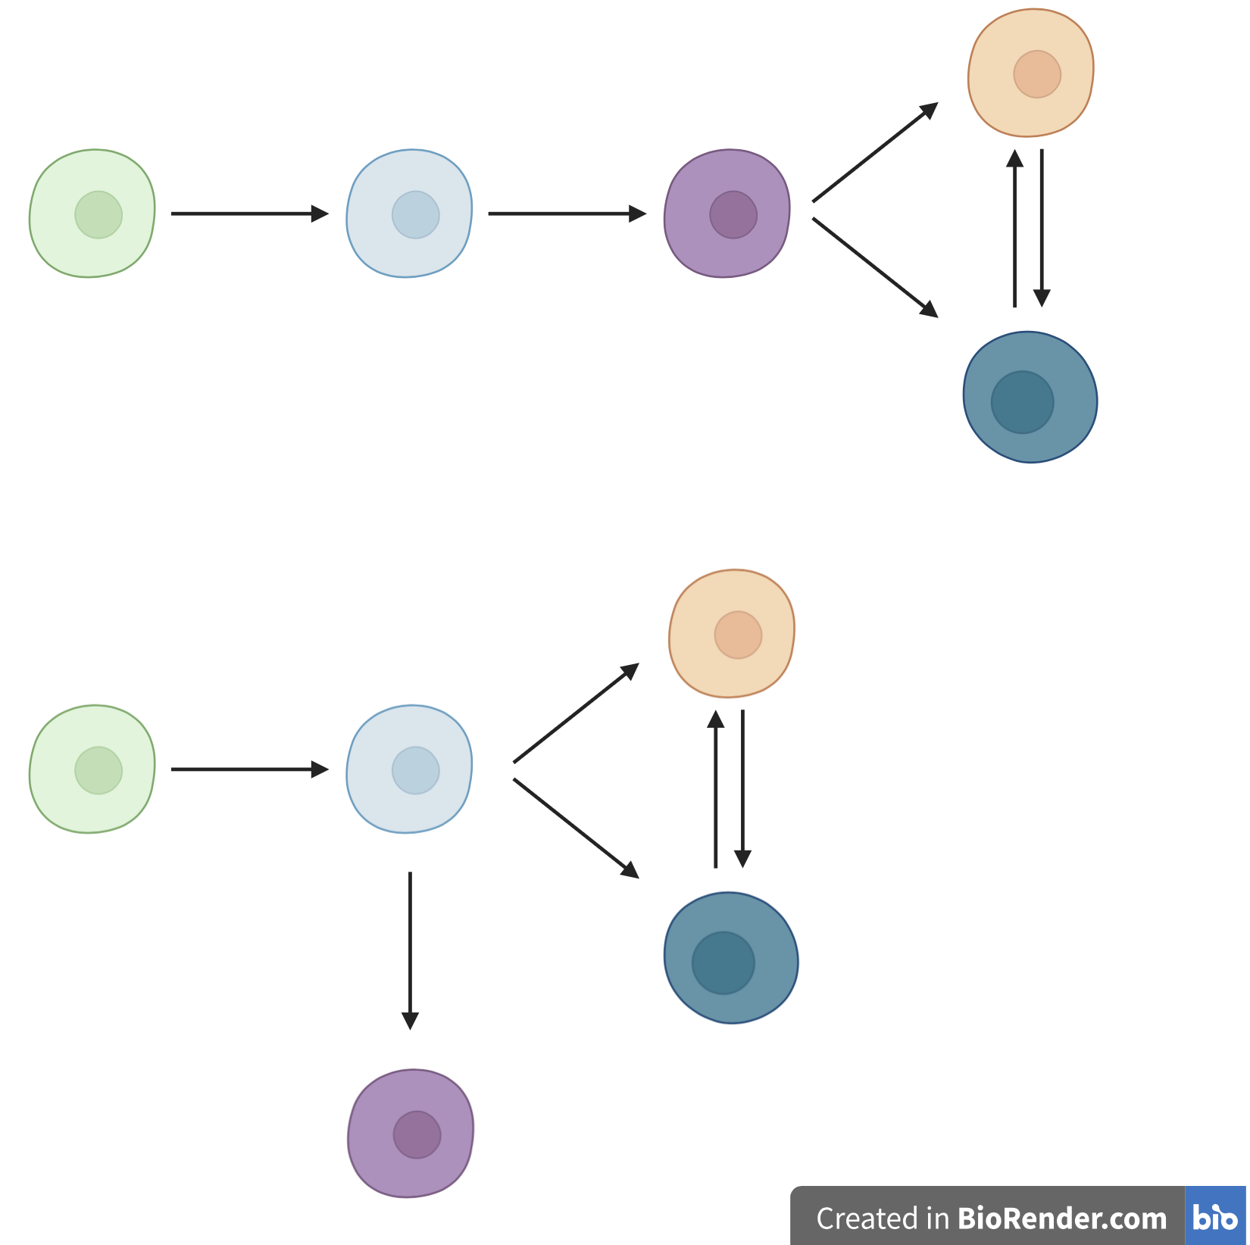
Central questions
1. Are PD-1⁺ and CD57⁺ T_{ex} epigenetically exhausted yet distinct here in teplizumab-treated subjects as observed with alefacept in TIDAL (Witkop, Commun Biol)?
2. How do the different cell populations’ epigenetic profiles differ?
3. What insights can we gain into CD8 TEM differentiation paths?
CD8 TEM differentiation models
DP PD-1⁺
DP
CD127⁺
TIGIT⁻
KLRG1⁻
TIGIT⁺
KLRG1⁺ (DP)
DP CD57⁺
Notes:
Hypothesis: beneficial teplizumab response mediated by expansion of specific populations of T_{ex}, T_{ex} heterogeneity may relate to response
Separate lineages is an oversimplification, likely overlapping populations (this is what we mean by heterogeneity)
PD1 and CD57 Tex are both hypo-proliferative andexpress IR in T1DAL study (alefacept)
TCR junction sequence identity between CD57+ and PD-1+ Tex, suggesting shared clonal relationships (fluid, bidirectional)
Both PD1+ and CD57+ Tex subsets share phenotypic (hypoproliferation, IR expression) and epigenetic signatures of Tex, with CD57 Tex having more open chromatin in lytic and KIR regulatory genes (Witkop, Commun Biol in revision)
CD57⁺ (also high for NK associated genes), marker of cytotoxic function
PD1 is an IR/activation marker
Motivation for point 2:
PD-1+ associated with better outcome
CD127+ associated with worse outcome
Point #1: i.e. are some more Tex?
T1DAL: alefacept (LFA3-Ig fusion, binds CD2, disrupts CD58-mediated costimulation of T cells, selectively depletes memory/effector T cells)
CD2 costimulation can prevent exhaustion, alefacept (anti-CD2) can help treat T1D i.e. by allowing exhaustion presumably
Teplizumab: humanized anti-CD3 monoclonal Ab to delay onset of stage 3 T1D in people with stage 2 T1D. mechanism: weak agonist of TCR-CD3 to induce anergy/apoptosis of T cells (i.e. autoreactive Teffs I presume)
Epigenetic analysis of PD-1⁺ Tex subset may inform clinical trial design with PD-1 agonism
16 samples from anti-CD3 (AbATE) treated T1D, peak of response
Estimated cell yields (30K sorted cells for bulk ATAC)
Responder = <40% decline in C-peptide AUC in two years
Teplizumab: humanized anti-CD3 monoclonal Ab to delay onset of stage 3 T1D in people with stage 2 T1D. mechanism: weak agonist of TCR-CD3 to induce anergy/apoptosis of T cells (i.e. autoreactive Teffs I presume)
Also took cells for CyTOF (Tex markers and Teff, I’m not sure of results from this though…)
Blocking IL7R seems to protect against T1D, so CD127+ is associated with worse T1D prognosis
Cellular differentiation and lineage commitment are often mediated by epigenetic mechanisms, including large changes in chromatin structure and gradual transition from a generally more open chromatin state in progenitor and stem cells to a more closed, compact chromatin state in differentiated cells
Biorender is simplification of overlapping cell pops

Slide 6
Different differentiation models have implications for effects of blocking CD127⁺ lineage
CD8 TEM differentiation models
DP PD-1⁺
DP
CD127⁺
X
TIGIT⁻
KLRG1⁻
TIGIT⁺
KLRG1⁺ (DP)
DP CD57⁺
X
Notes:
Separate lineages is an oversimplification, likely overlapping populations (this is what we mean by heterogeneity)
PD1 and CD57 Tex are both hypo-proliferative andexpress IR in T1DAL study (alefacept)
TCR junction sequence identity between CD57+ and PD-1+ Tex, suggesting shared clonal relationships (fluid, bidirectional)
Both PD1+ and CD57+ Tex subsets share phenotypic (hypoproliferation, IR expression) and epigenetic signatures of Tex, with CD57 Tex having more open chromatin in lytic and KIR regulatory genes (Witkop, Commun Biol in revision)
CD57⁺ (also high for NK associated genes), marker of cytotoxic function
PD1 is an IR/activation marker
Motivation for point 2:
PD-1+ associated with better outcome
CD127+ associated with worse outcome
Point #1: i.e. are some more Tex?
T1DAL: alefacept (LFA3-Ig fusion, binds CD2, disrupts CD58-mediated costimulation of T cells, selectively depletes memory/effector T cells)
CD2 costimulation can prevent exhaustion, alefacept (anti-CD2) can help treat T1D i.e. by allowing exhaustion presumably
Teplizumab: humanized anti-CD3 monoclonal Ab to delay onset of stage 3 T1D in people with stage 2 T1D. mechanism: weak agonist of TCR-CD3 to induce anergy/apoptosis of T cells (i.e. autoreactive Teffs I presume)
Epigenetic analysis of PD-1⁺ Tex subset may inform clinical trial design with PD-1 agonism
16 samples from anti-CD3 (AbATE) treated T1D, peak of response
Estimated cell yields (30K sorted cells for bulk ATAC)
Responder = <40% decline in C-peptide AUC in two years
Teplizumab: humanized anti-CD3 monoclonal Ab to delay onset of stage 3 T1D in people with stage 2 T1D. mechanism: weak agonist of TCR-CD3 to induce anergy/apoptosis of T cells (i.e. autoreactive Teffs I presume)
Also took cells for CyTOF (Tex markers and Teff, I’m not sure of results from this though…)
Blocking IL7R seems to protect against T1D, so CD127+ is associated with worse T1D prognosis, CD57+ and PD-1+ are beneficial I think (not sure where evidence is…) so blocking IL7R having protection maybe argues against CD127+ being precursor?
Cellular differentiation and lineage commitment are often mediated by epigenetic mechanisms, including large changes in chromatin structure and gradual transition from a generally more open chromatin state in progenitor and stem cells to a more closed, compact chromatin state in differentiated cells
Biorender is simplification of overlapping cell pops

Slide 7
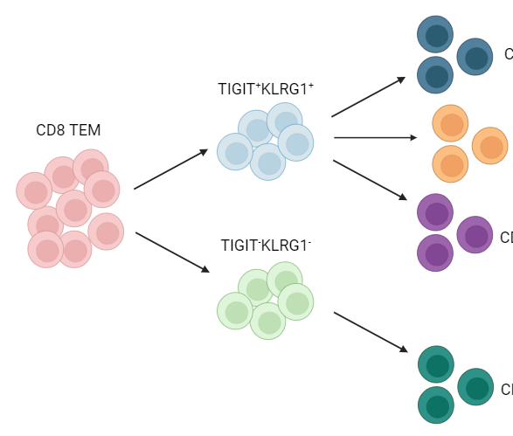
Study design
bulk ATAC-seq of 5 populations (bolded)
TIGIT⁺
KLRG1⁺ (DP)
DP CD57⁺
not-naive
CD8s
DP PD1⁺
AbATE (teplizumab) subjects
DP CD127⁺
TIGIT⁻KLRG1⁻ (DN)
non-exhausted (not DP) CD127⁺
6 responders, TIGIT⁺KLRG1⁺ high
sort
4 non-responders, TIGIT⁺KLRG1⁺ low
CyTOF
Ask about CyTOF data when sending slides
Notes:
KLRG1: co-inhibitory receptor belonging to inhibitory killer cell lectin-like receptors on NK cells and antigen-experienced human T cells, thought to be a senescent marker for human T cells with poor proliferation and impaired clonal expansion after stimulation
CD127 = IL7R
Motivation for point 2:
PD-1+ associated with better outcome
CD127+ associated with worse outcome
Point #1: i.e. are some more Tex?
T1DAL: alefacept (LFA3-Ig fusion, binds CD2, disrupts CD58-mediated costimulation of T cells, selectively depletes memory/effector T cells)
CD2 costimulation can prevent exhaustion, alefacept (anti-CD2) can help treat T1D i.e. by allowing exhaustion presumably
Teplizumab: humanized anti-CD3 monoclonal Ab to delay onset of stage 3 T1D in people with stage 2 T1D. mechanism: weak agonist of TCR-CD3 to induce anergy/apoptosis of T cells (i.e. autoreactive Teffs I presume)
Epigenetic analysis of PD-1⁺ Tex subset may inform clinical trial design with PD-1 agonism
10 samples from anti-CD3 (AbATE) treated T1D, peak of response
Estimated cell yields (30K sorted cells for bulk ATAC)
Responder = <40% decline in C-peptide AUC in two years
Teplizumab: humanized anti-CD3 monoclonal Ab to delay onset of stage 3 T1D in people with stage 2 T1D. mechanism: weak agonist of TCR-CD3 to induce anergy/apoptosis of T cells (i.e. autoreactive Teffs I presume)
Also took cells for CyTOF (Tex markers and Teff, I’m not sure of results from this though…)
Blocking IL7R seems to protect against T1D, so CD127+ is associated with worse T1D prognosis

Slide 8
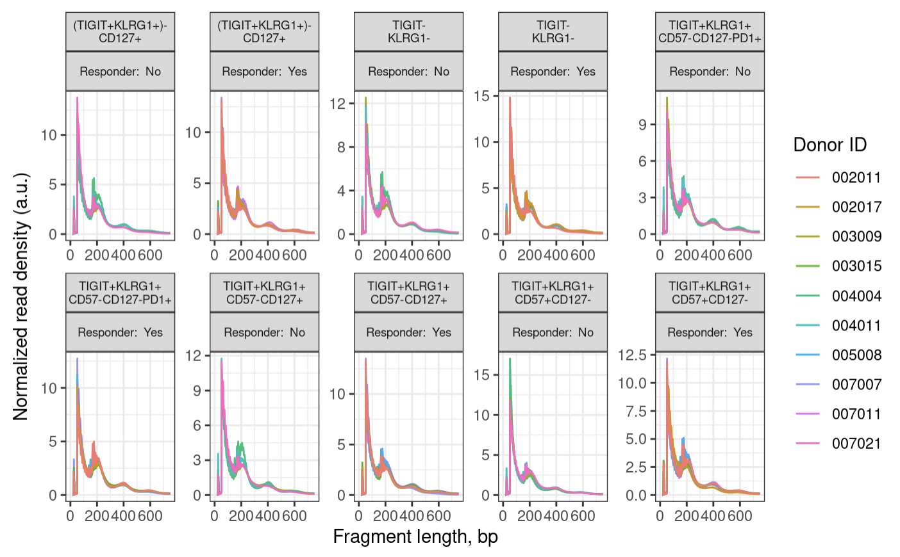
Fragment size distributions pass QC
Non-exhausted CD127⁺
Non-exhausted CD127⁺
DN
DN
DP PD-1⁺
DP PD-1⁺
DP CD127⁺
DP CD127⁺
DP CD57⁺
DP CD57⁺
Notes:
100 bp peak, 200, 400 bp oscillations
expect a peak around 100 bp (nuclesome free region) and then oscillations with maxima 200 bp mono-nucleosome, 400 bp di-nucleosome and so on
wiggles in the below plot are a biological feature and come from 10 bp per helical turn of the DNA
200 is like 2 100s together due to a nucleosome b/w preventing cut

Slide 9
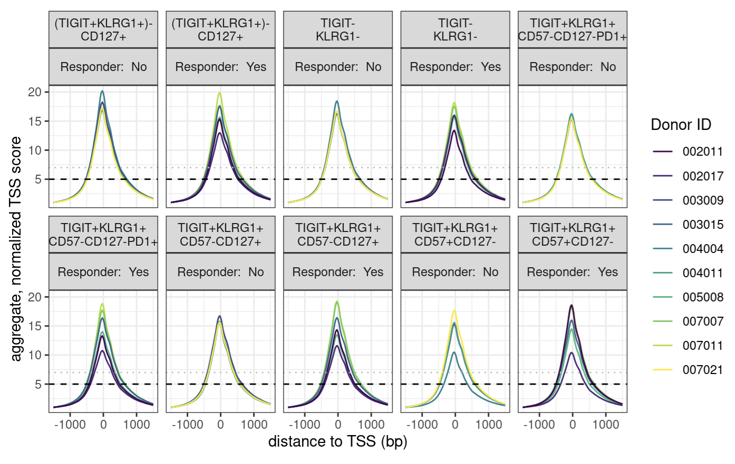
Enrichment over the TSS passes
Non-exhausted CD127⁺
Non-exhausted CD127⁺
DN
DN
DP PD-1⁺
DP PD-1⁺
DP CD127⁺
DP CD127⁺
DP CD57⁺
DP CD57⁺
Notes:
enrichment over TSS, signal:noise
we are looking for > 7, while 5-7 is still acceptable

Slide 10
After QC (all libraries pass)
Merge alignment .bam files by study group (cell sort + responder status)
Call peaks on merged alignment files
Merge peaks to obtain “consensus peaks” (candidate genomic regions with biological relevancy across samples & study groups)
Notes:
Merging alignment bams ~= pile up reads
Steps 1-2 ~ pseudobulking for RNA degs
Consensus = relevant across samples vs. just in 1/few samples
Consensus peaks = candidate regions (binned genome), we need them because we need to be looking at peaks that are relevant across samples vs. peaks just in 1/few samples?
*2-4 are an alternative to default of obtaining consensus peaks by fixed list of 400 bp wide peaks overlapping between > 2 samples (washes out signal)
This approach deals with different peak widths across samples better, obtaining more representative peaks, should be more sensitive
Is this kind of like pseudobulking?

Slide 11
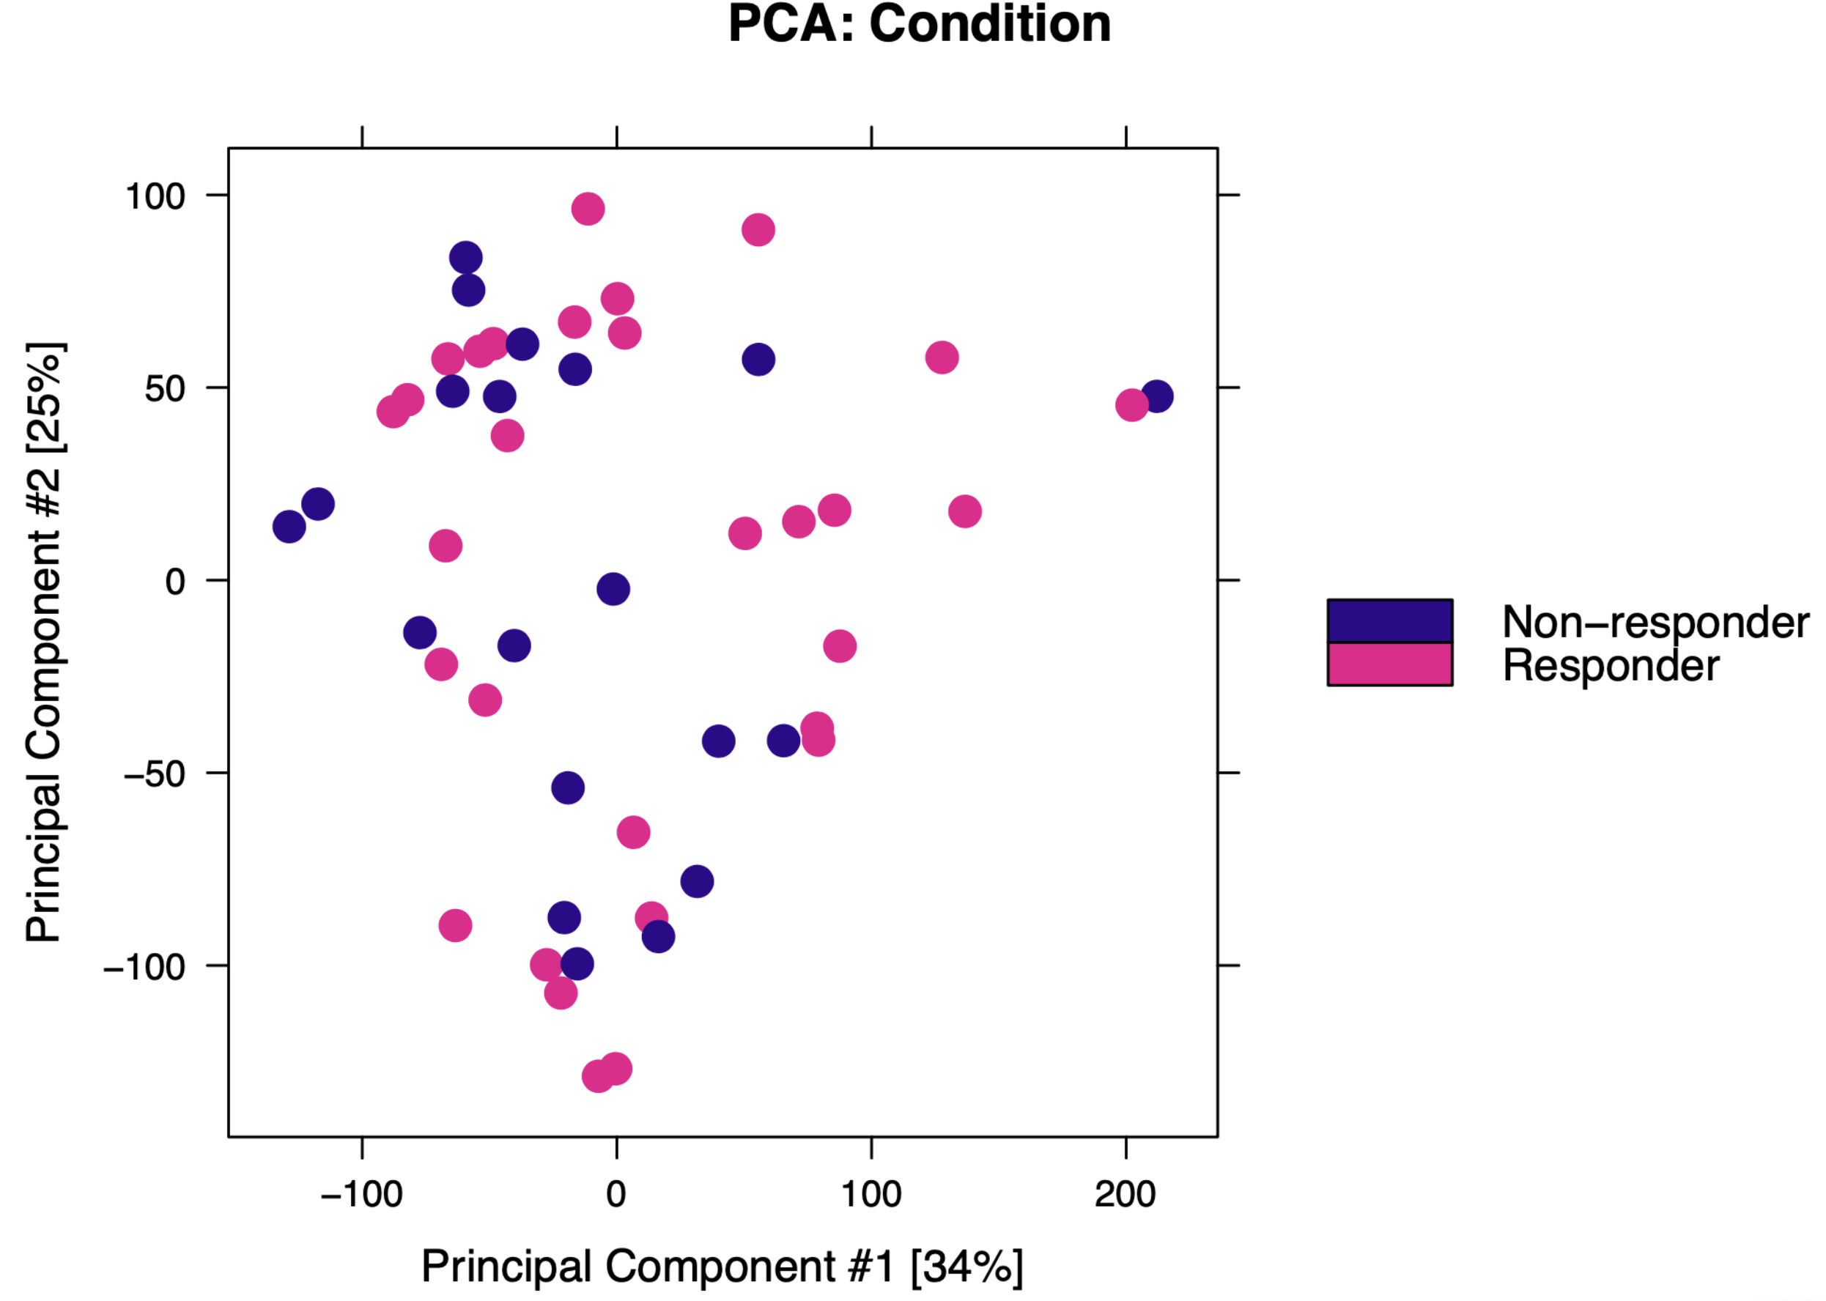
Epigenetic profiles between responders and non-responders are similar
R & NR grouped for all subsequent analyses

Slide 12
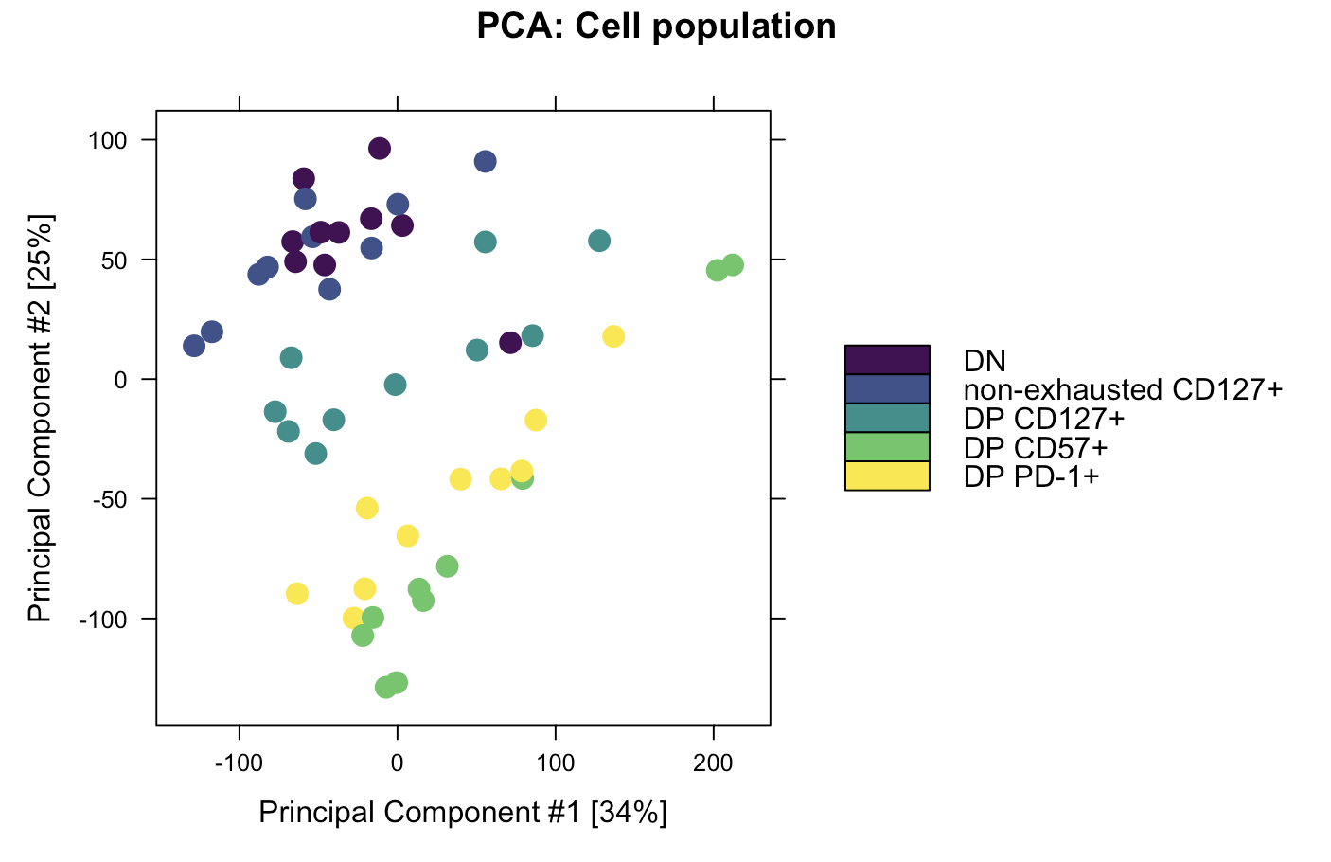
Epigenetic profiles of cell types differ

Slide 13
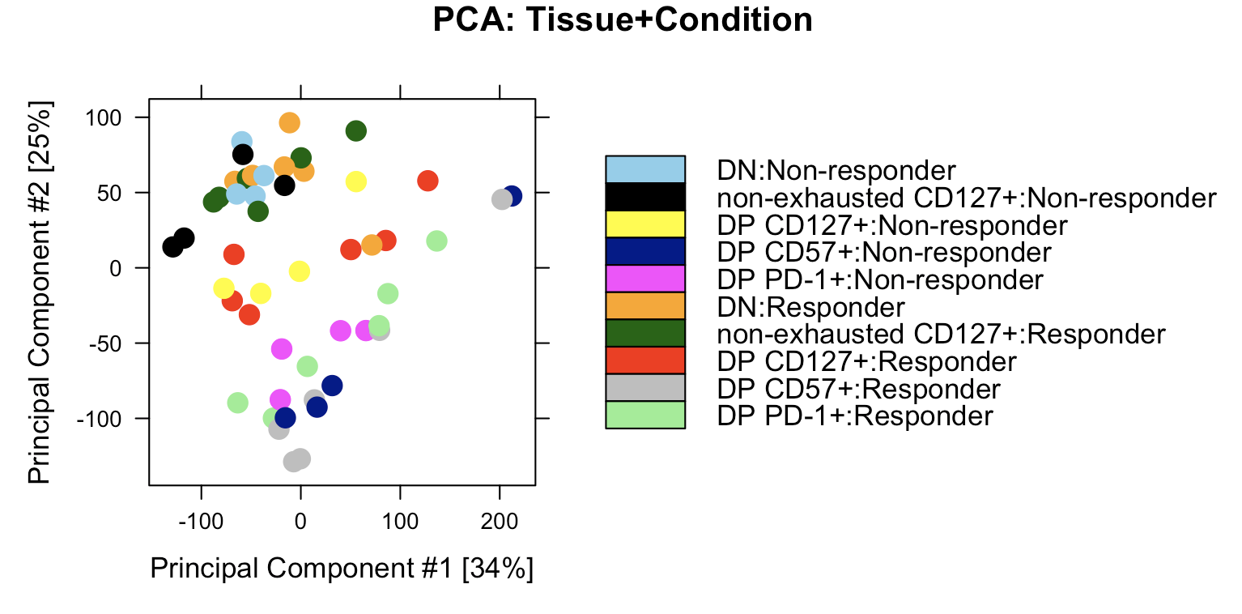
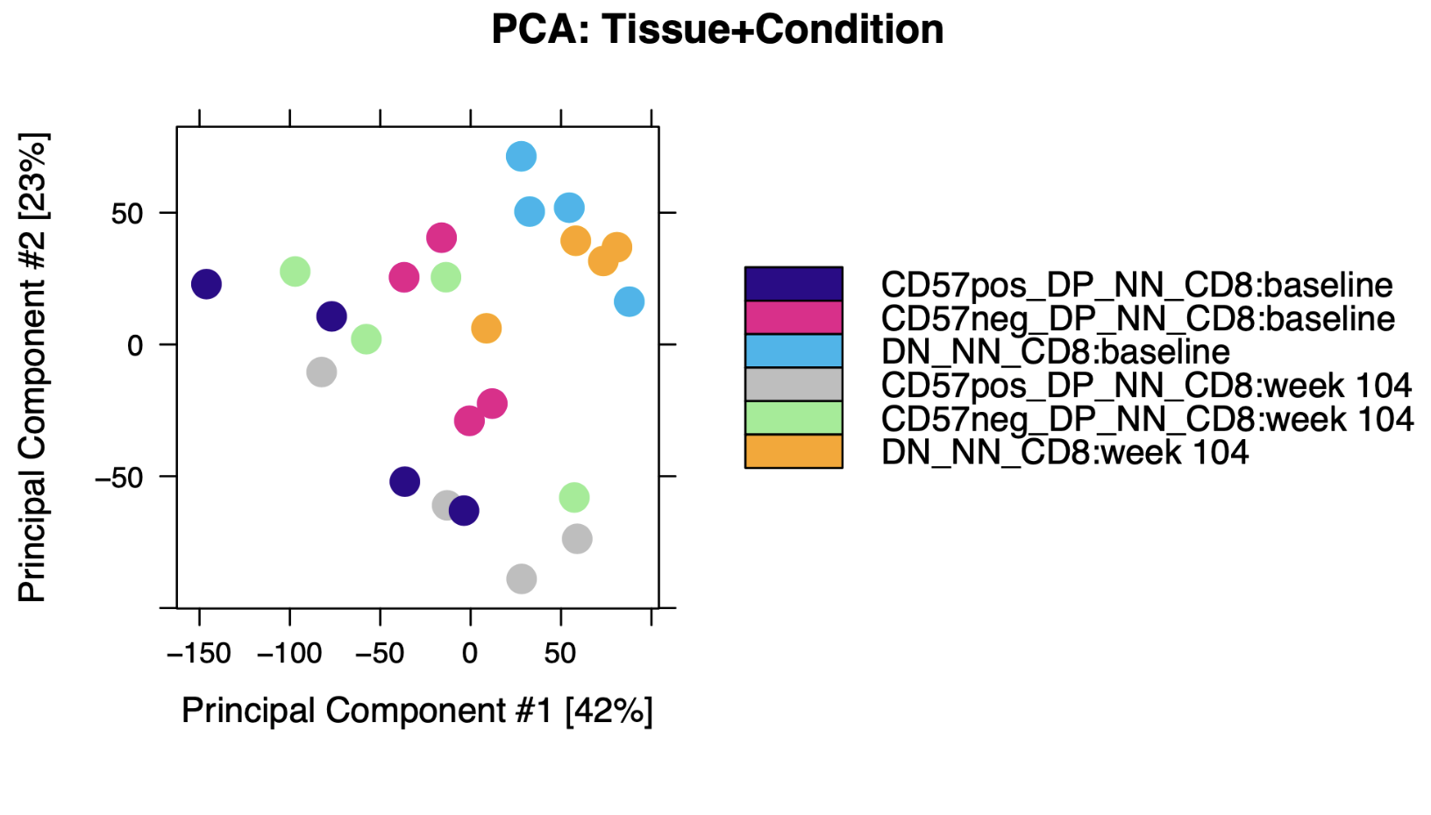
Donor to donor variability is comparable with P452 T1DAL analyses
DP CD57⁺:baseline
DP PD-1⁺: baseline
DN: baseline
DP CD57⁺: week 104
DP PD-1⁺: week 104
DN: week 104
P576
P452

Slide 14
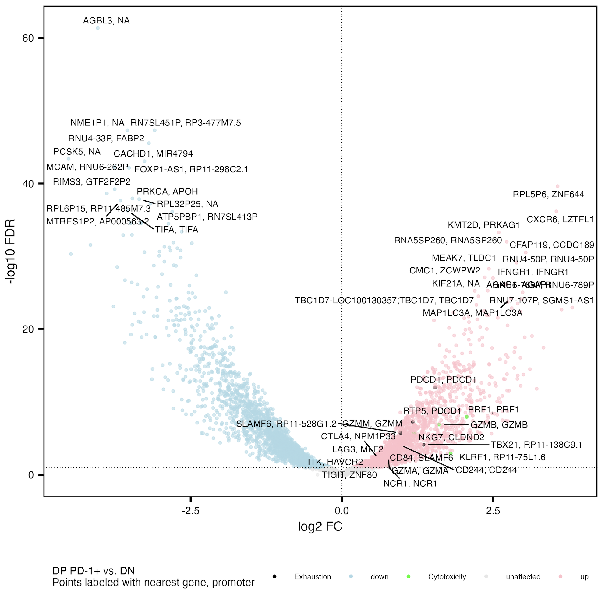
Cytotoxicity and exhaustion genes more accessible in DP PD-1⁺ vs. DN
Similar to Erin’s P452 T1DAL analyses
Probably need to run these by an immunologist, like KLRF1…
Exhaustion: CD244, SLAMF6, TBX21, PDCD1, HAVCR2, KLRG1, TOX, TCF1, PD1, CTLA4, LAG3, TIM3, TIGIT, KIR3DL2, KIR2DL3, NKG2A
Cytotoxicity: GZMA, GZMB, GZMH, GZMM, GZMK, PRF1, NCR1, KLRF1, NKG7
Notes:
Erin’s PD-1 up vs. DN: GZMB, GZMH, LAG3, TBX21, NKG7, CD244, KLRF1
Cytotoxicity up even though “exhausted” because DP is only partially exhausted? And DN can have other exhaustion markers I suppose

Slide 15
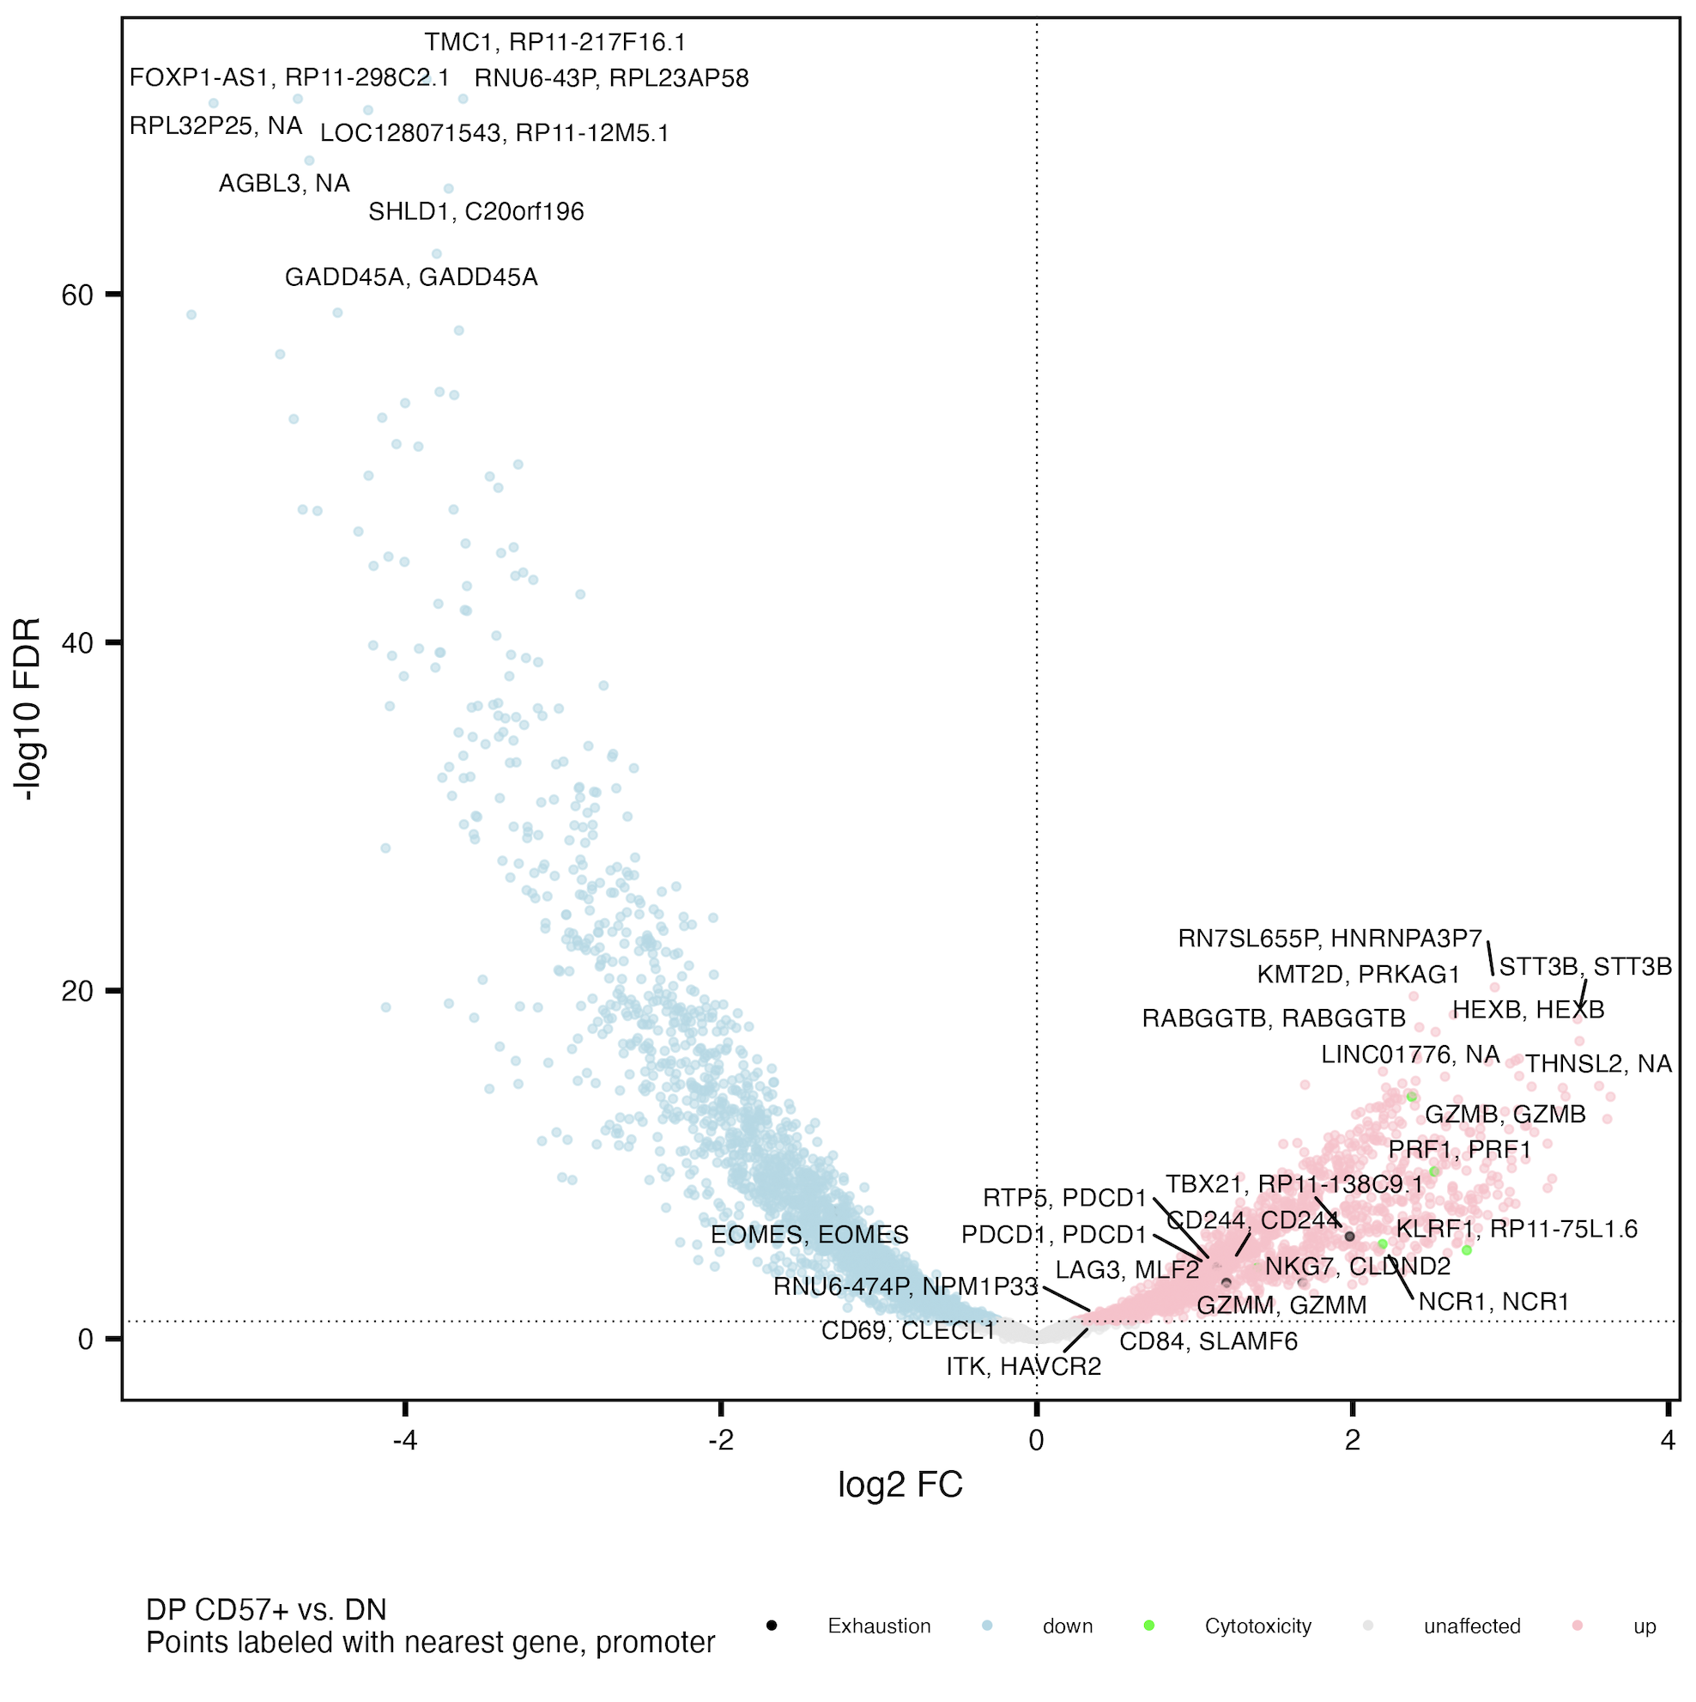
Cytotoxicity and exhaustion genes generally more accessible in DP CD57⁺ vs. DN
Similar to Erin’s P452 T1DAL analyses
Exhaustion: CD244, SLAMF6, TBX21, PDCD1, HAVCR2, KLRG1, TOX, TCF1, PD1, CTLA4, LAG3, TIM3, TIGIT, KIR3DL2, KIR2DL3, NKG2A
Cytotoxicity: GZMA, GZMB, GZMH, GZMM, GZMK, PRF1, NCR1, KLRF1, NKG7
Notes:
Erin’s CD57 up vs. DN: GZMB/GZMH, NCR1, KLRF1, CD244, SLAMF6, LAG3, TBX21, PDCD1

Slide 16
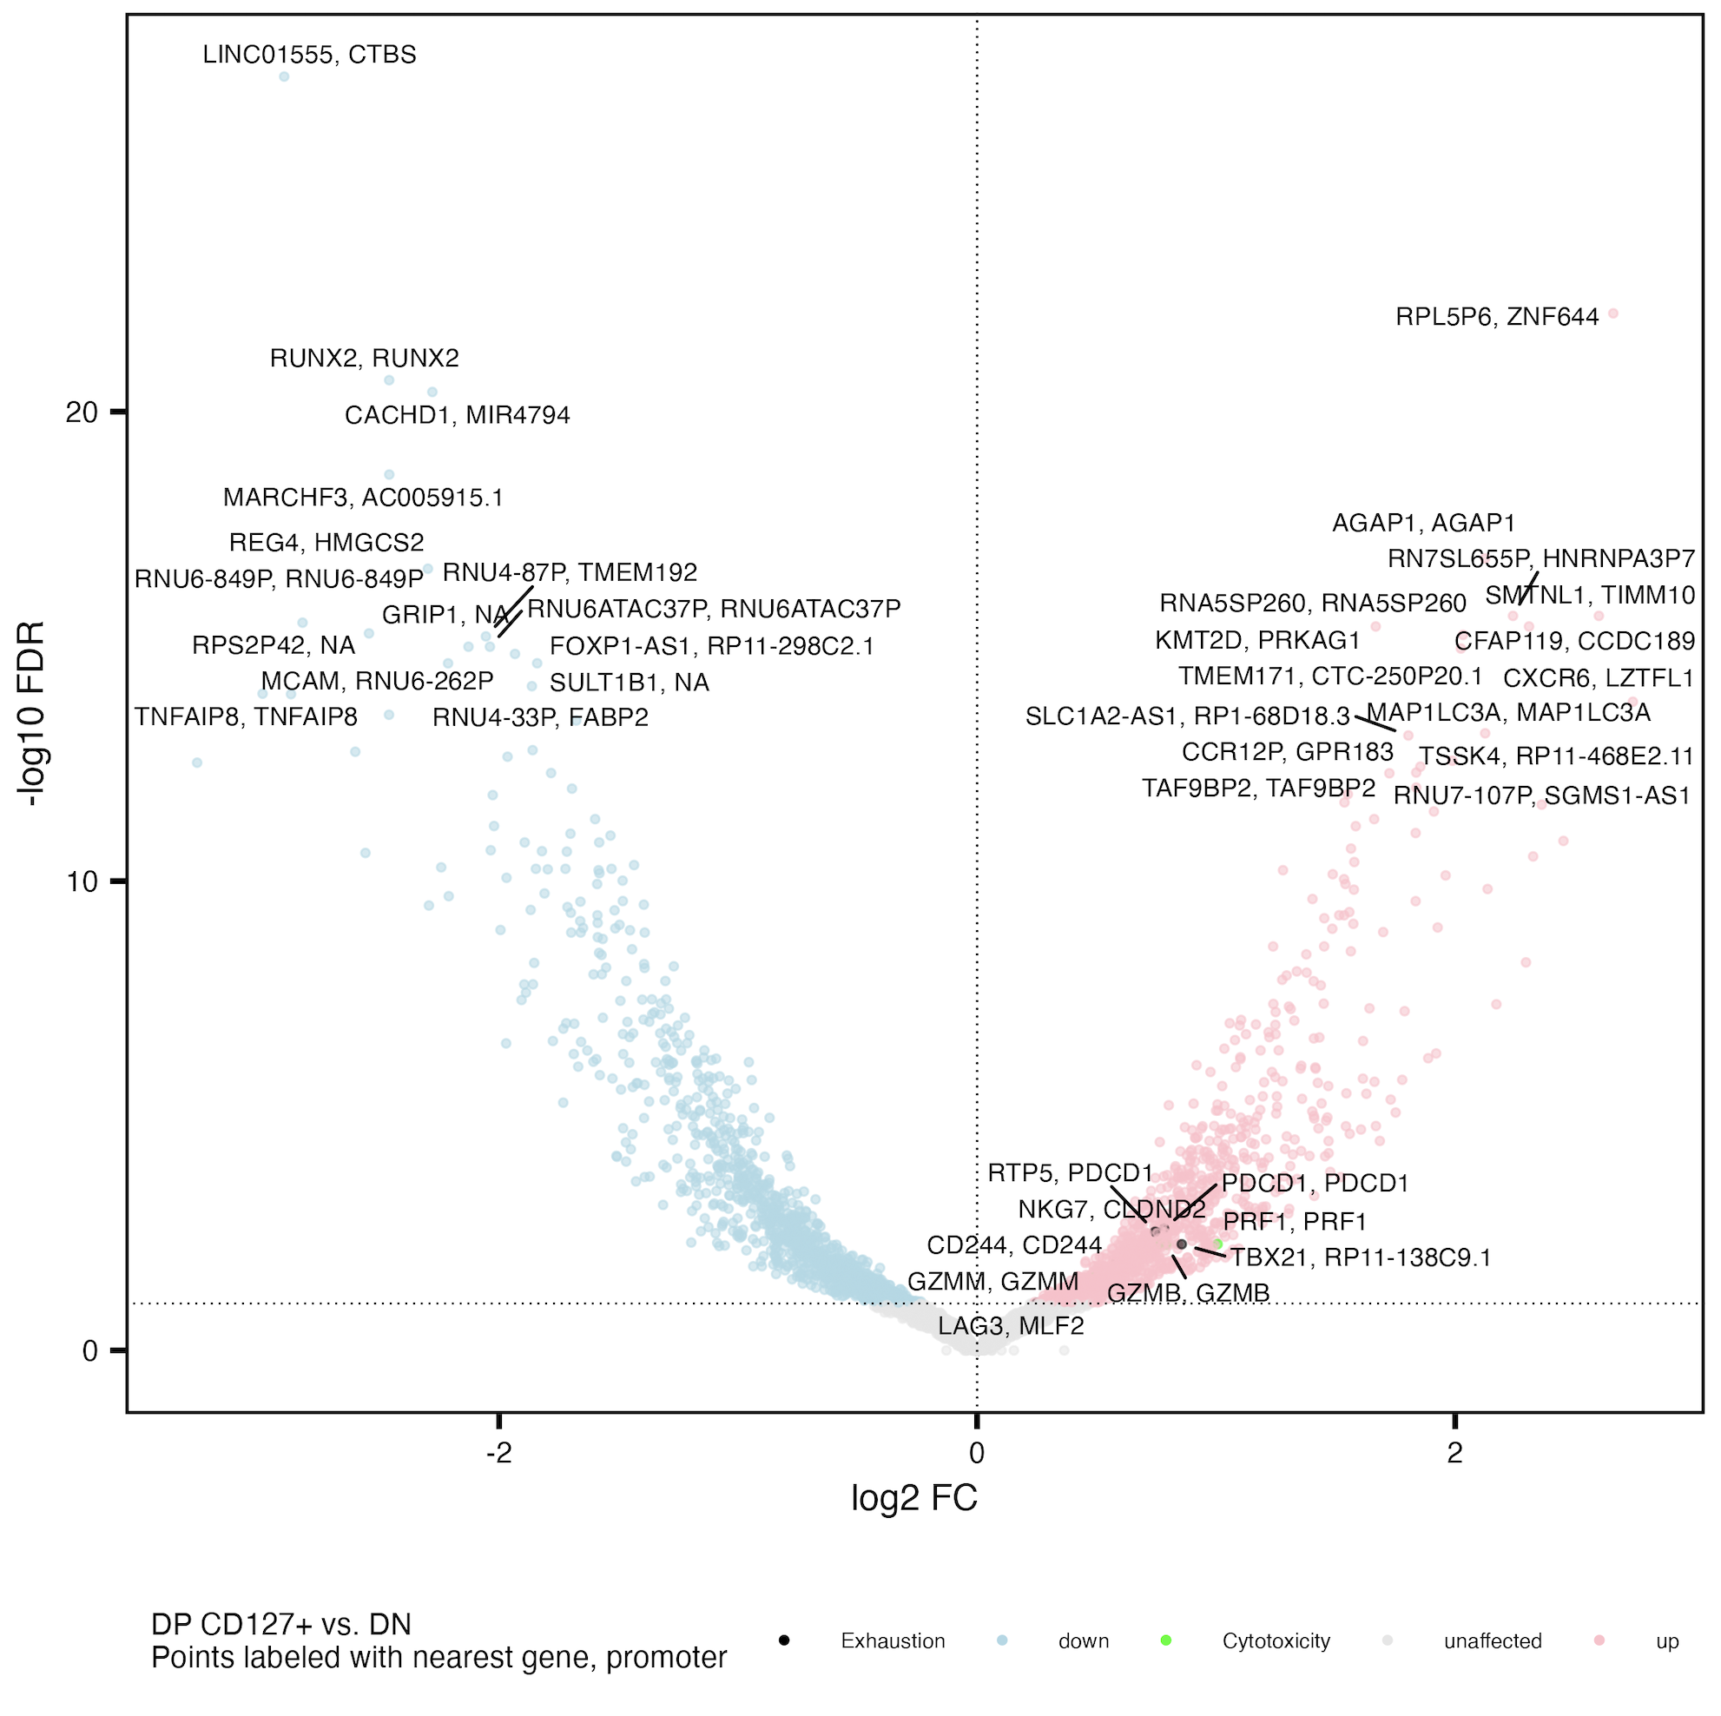
Cytotoxicity and exhaustion genes more accessible in DP CD127⁺ vs. DN
Exhaustion: CD244, SLAMF6, TBX21, PDCD1, HAVCR2, KLRG1, TOX, TCF1, PD1, CTLA4, LAG3, TIM3, TIGIT, KIR3DL2, KIR2DL3, NKG2A
Cytotoxicity: GZMA, GZMB, GZMH, GZMM, GZMK, PRF1, NCR1, KLRF1, NKG7

Slide 17
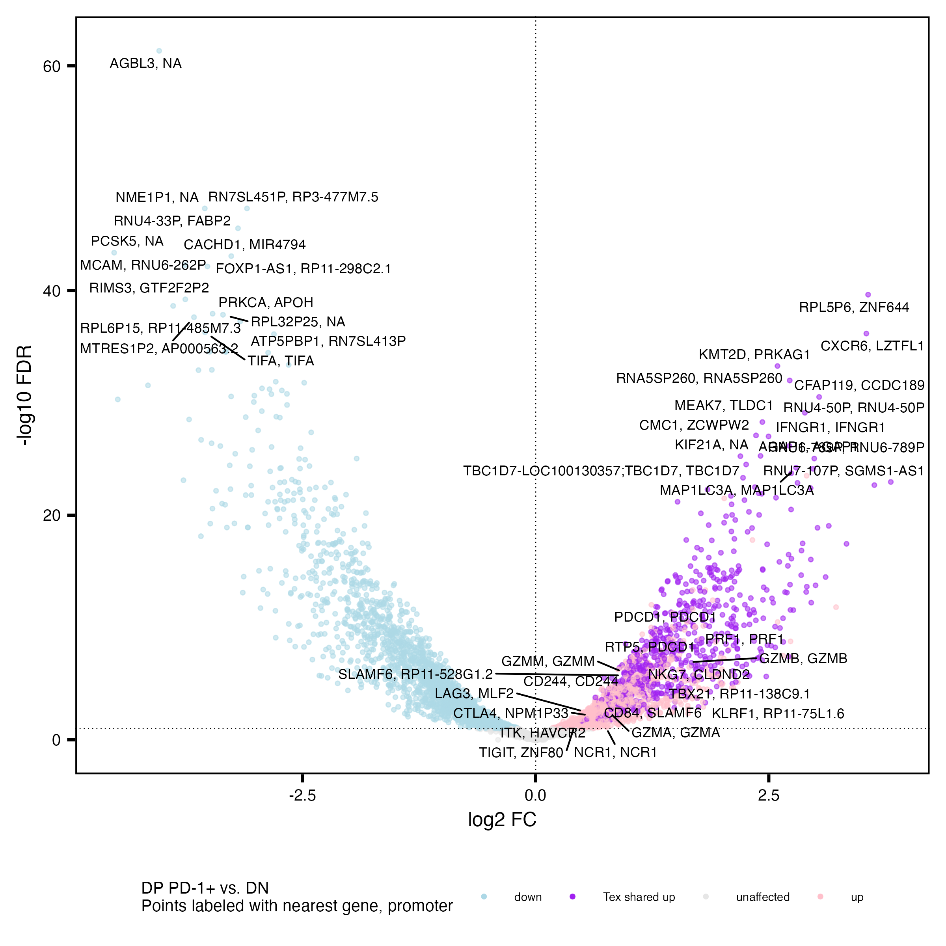
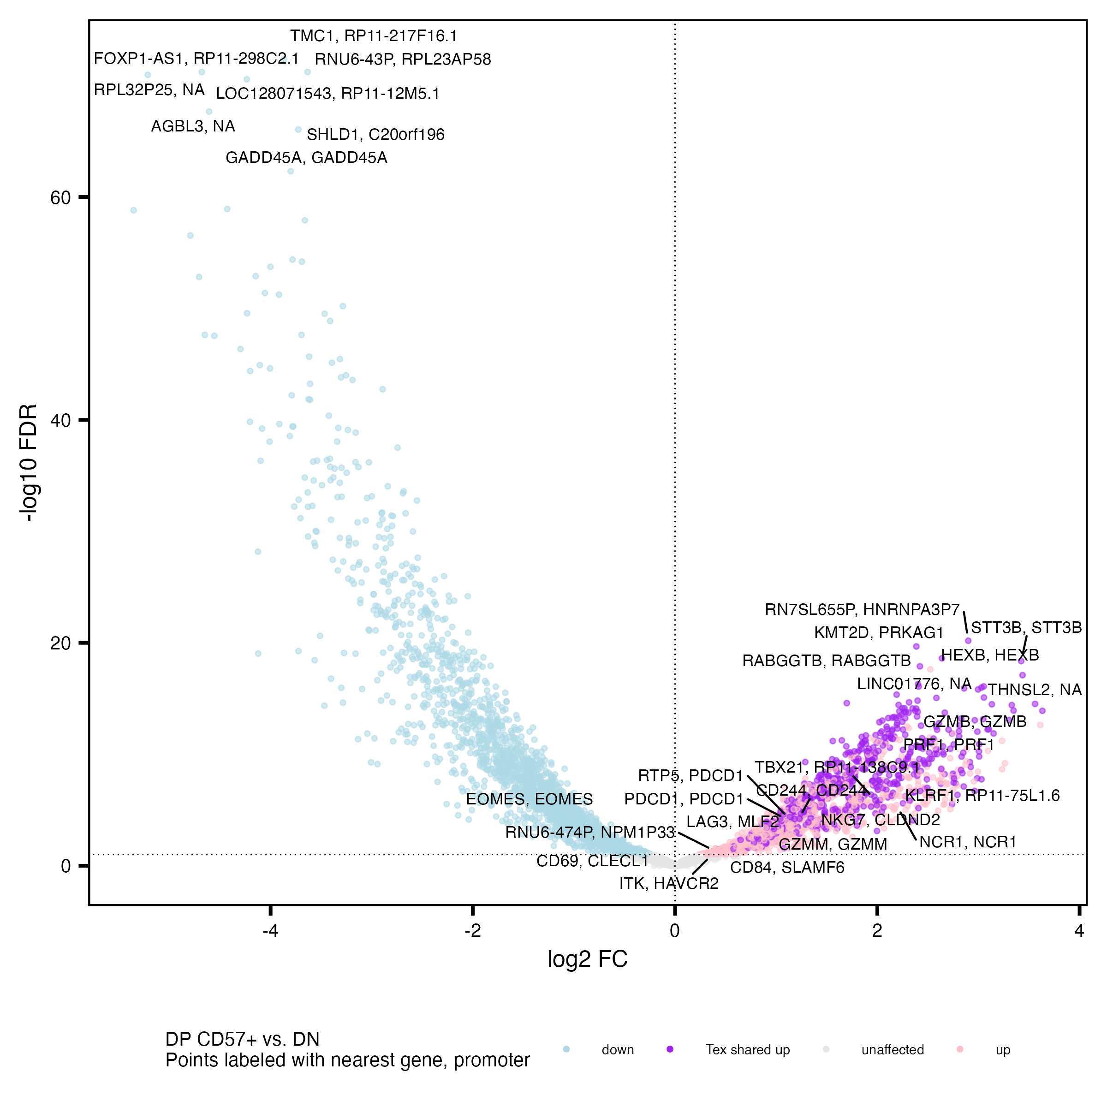
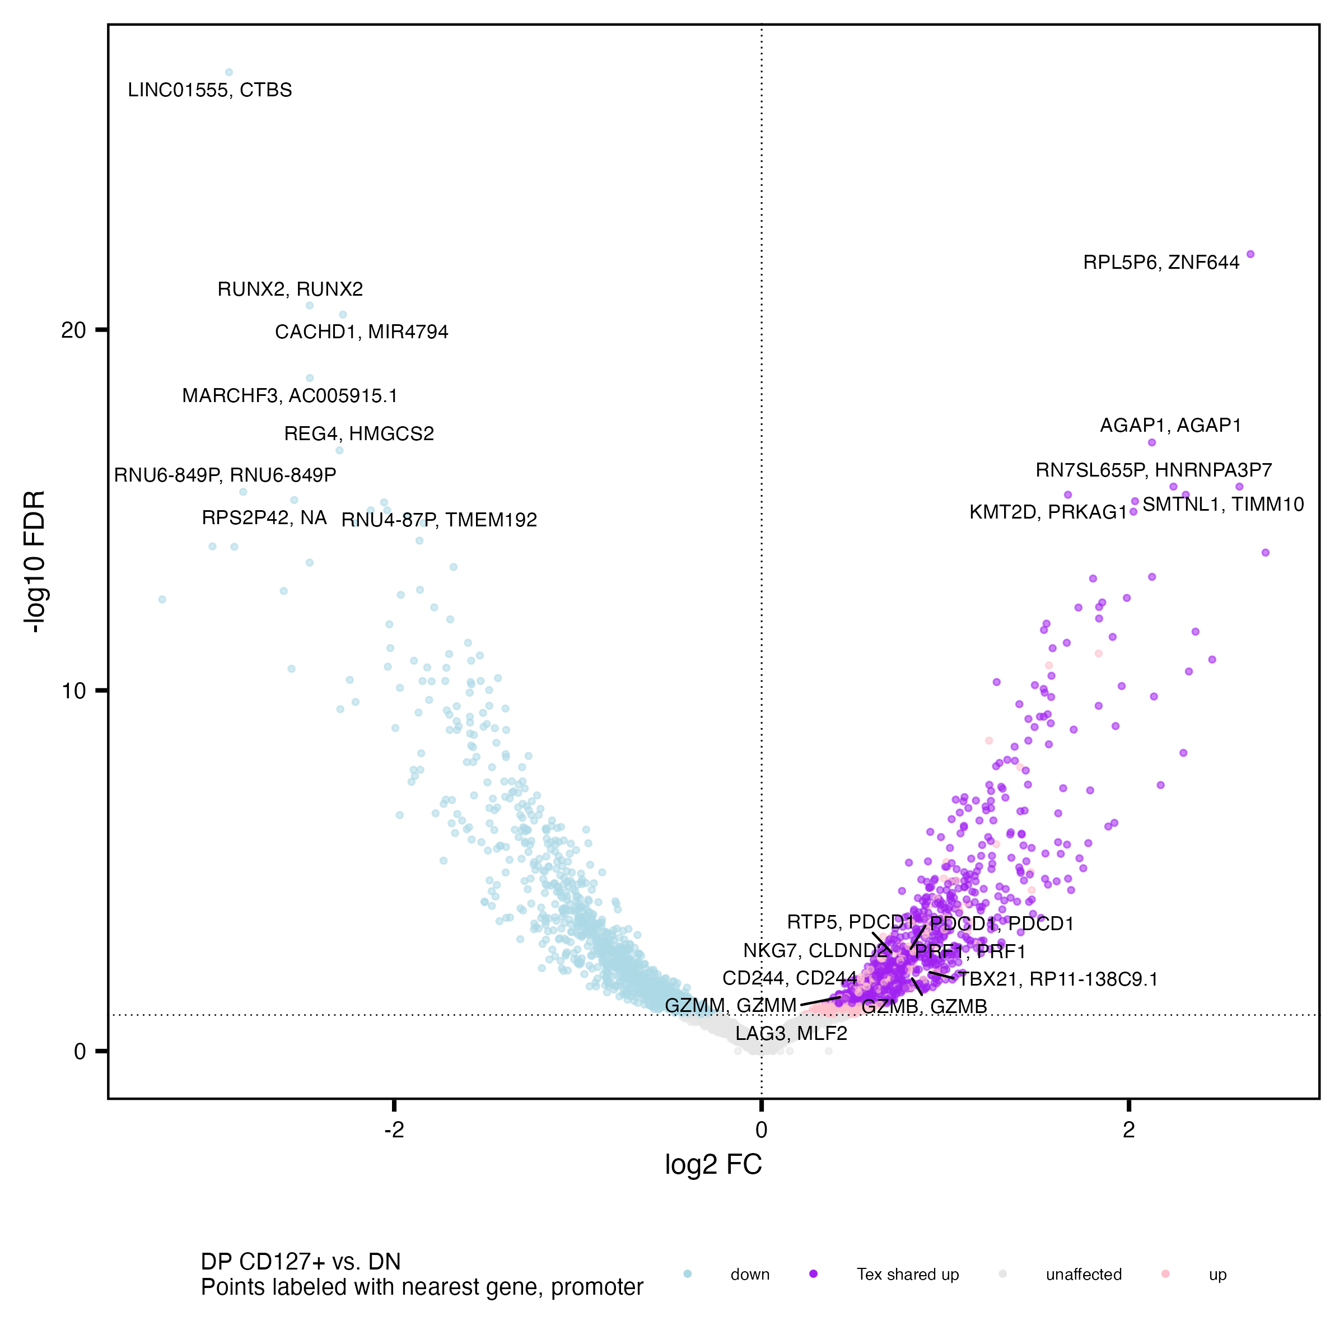
DP populations share many up vs. DN peaks’ closest genes with each other

Slide 18
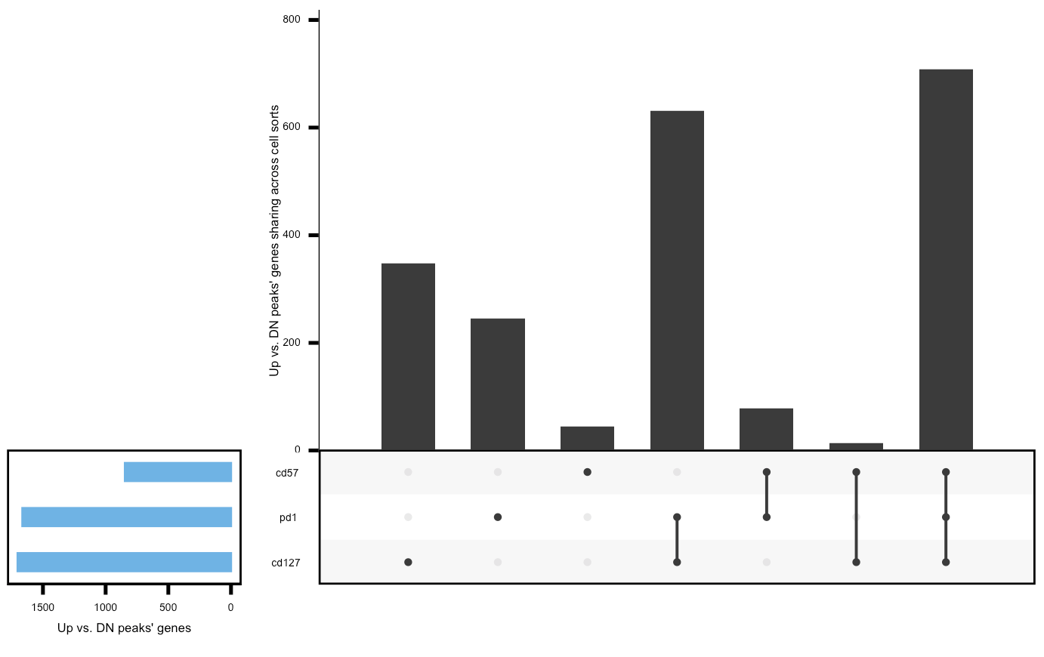
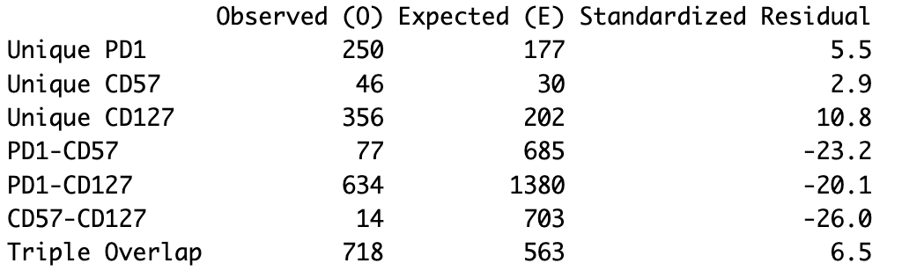
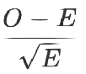
DP populations have more than expected triple overlap and unique sets of up peaks’ genes vs. DN, less than expected double overlaps, perhaps related to T_{ex} heterogeneity
Expected values from 5,000
simulations
2,095 distinct up genes vs. DN across DPs
Observed values
Notes:
filtered for differentially accessible peaks with highest abs(FC) per gene (or promoter, similar results if using median)
then filtered for FC > 0 vs. DN
similar results if filtering for peaks < 5 kb from genes, looks similar for promoters
KIRs aren’t present in the unique to DP CD57⁺ fraction (not surprising, they don’t show up vs. DN, only vs. DP PD-1⁺)

Slide 19
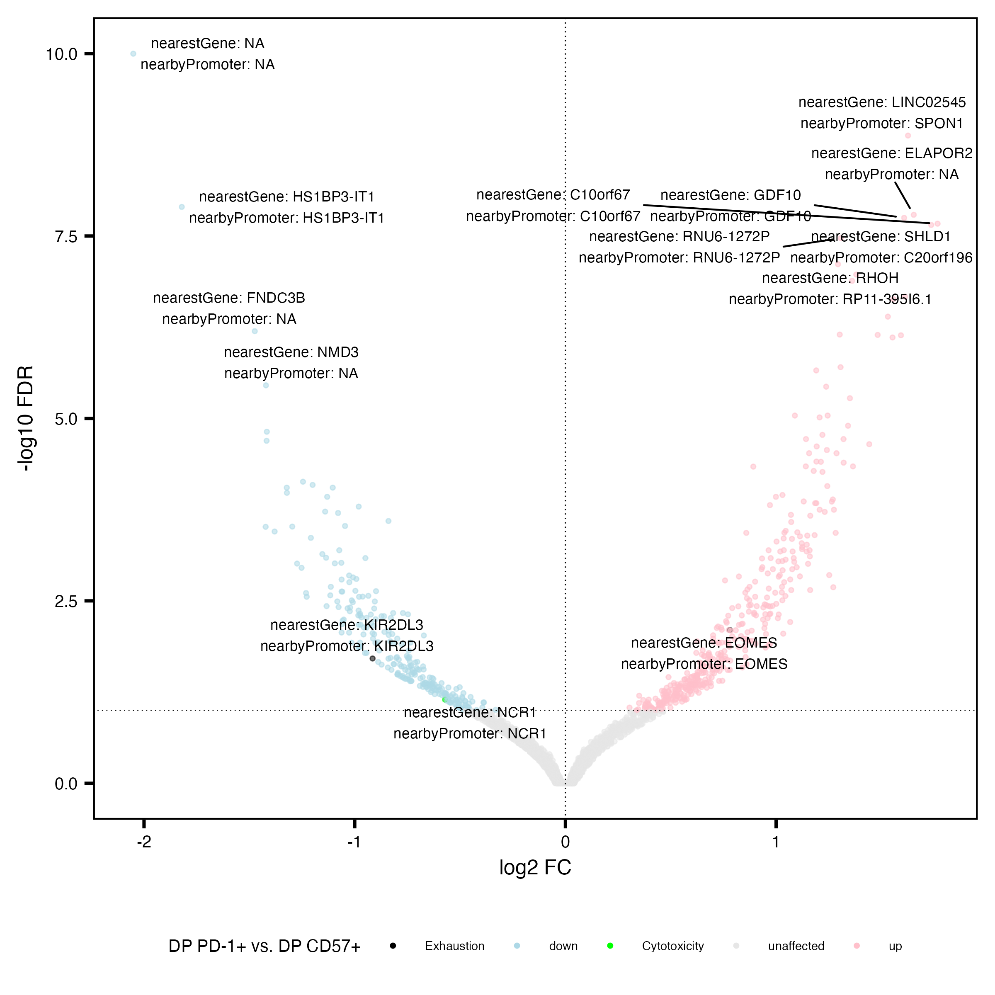
KIR2DL3 more accessible in DP CD57⁺ vs. DP PD-1⁺
Similar to Erin’s P452 T1DAL analyses
Exhaustion: CD244, SLAMF6, TBX21, PDCD1, HAVCR2, KLRG1, TOX, TCF1, PD1, CTLA4, LAG3, TIM3, TIGIT, KIR3DL2, KIR2DL3, NKG2A
Cytotoxicity: GZMA, GZMB, GZMH, GZMM, GZMK, PRF1, NCR1, KLRF1, NKG7

Slide 20
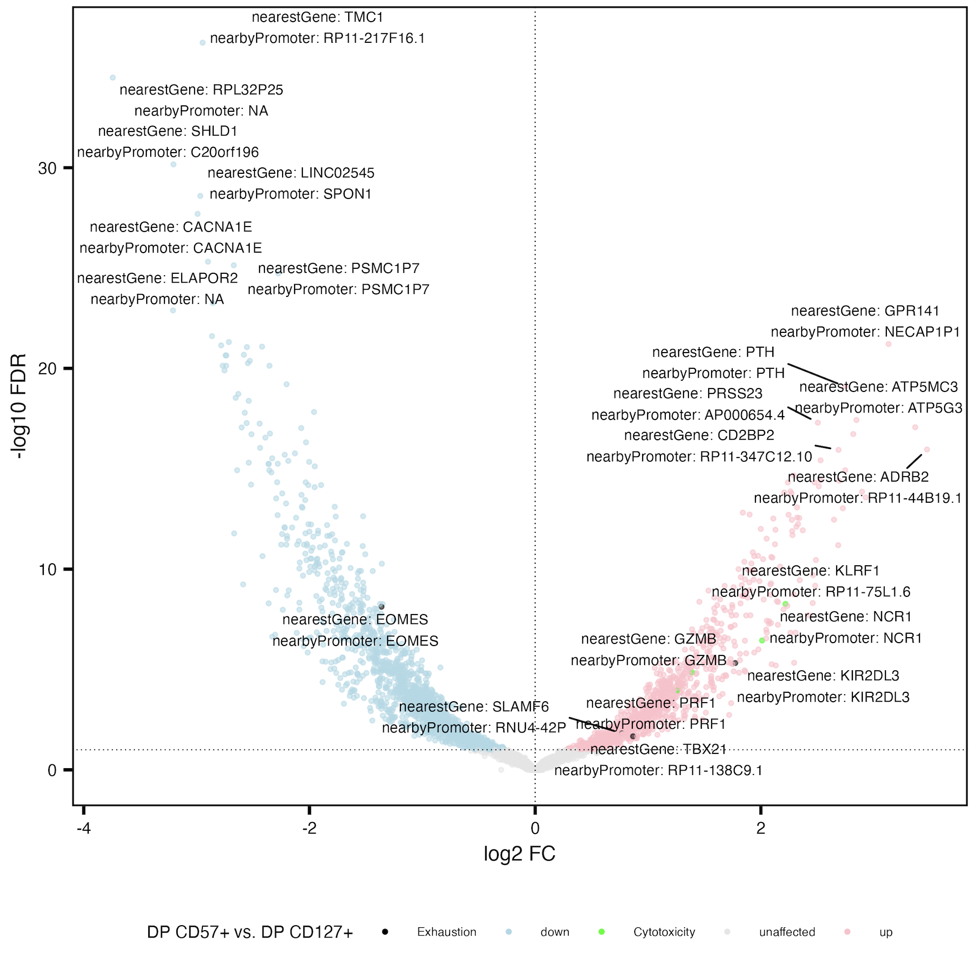
KIRs also more accessible in DP CD57⁺ vs. DP CD127⁺
Exhaustion: CD244, SLAMF6, TBX21, PDCD1, HAVCR2, KLRG1, TOX, TCF1, PD1, CTLA4, LAG3, TIM3, TIGIT, KIR3DL2, KIR2DL3, NKG2A
Cytotoxicity: GZMA, GZMB, GZMH, GZMM, GZMK, PRF1, NCR1, KLRF1, NKG7

Slide 21
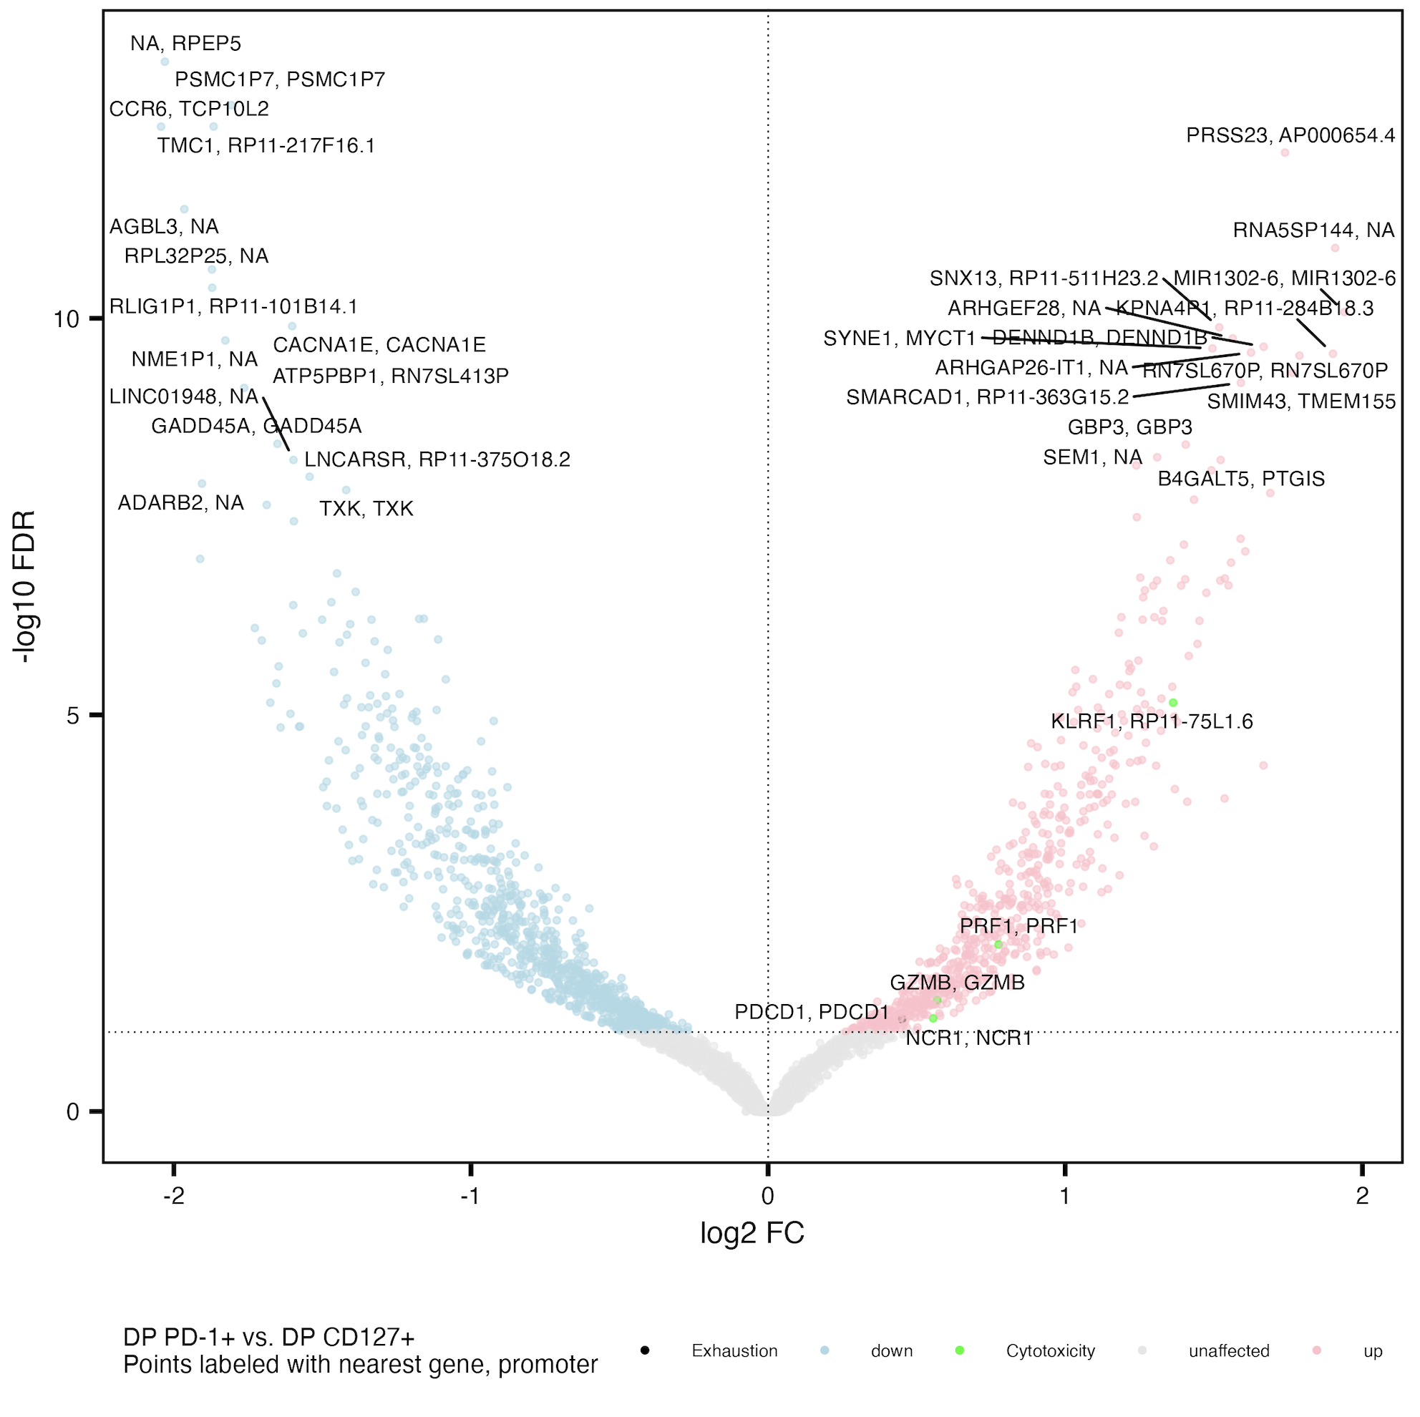
Cytotoxicity genes more accessible in DP PD-1⁺ vs. DP CD127⁺
Exhaustion: CD244, SLAMF6, TBX21, PDCD1, HAVCR2, KLRG1, TOX, TCF1, PD1, CTLA4, LAG3, TIM3, TIGIT, KIR3DL2, KIR2DL3, NKG2A
Cytotoxicity: GZMA, GZMB, GZMH, GZMM, GZMK, PRF1, NCR1, KLRF1, NKG7

Slide 22
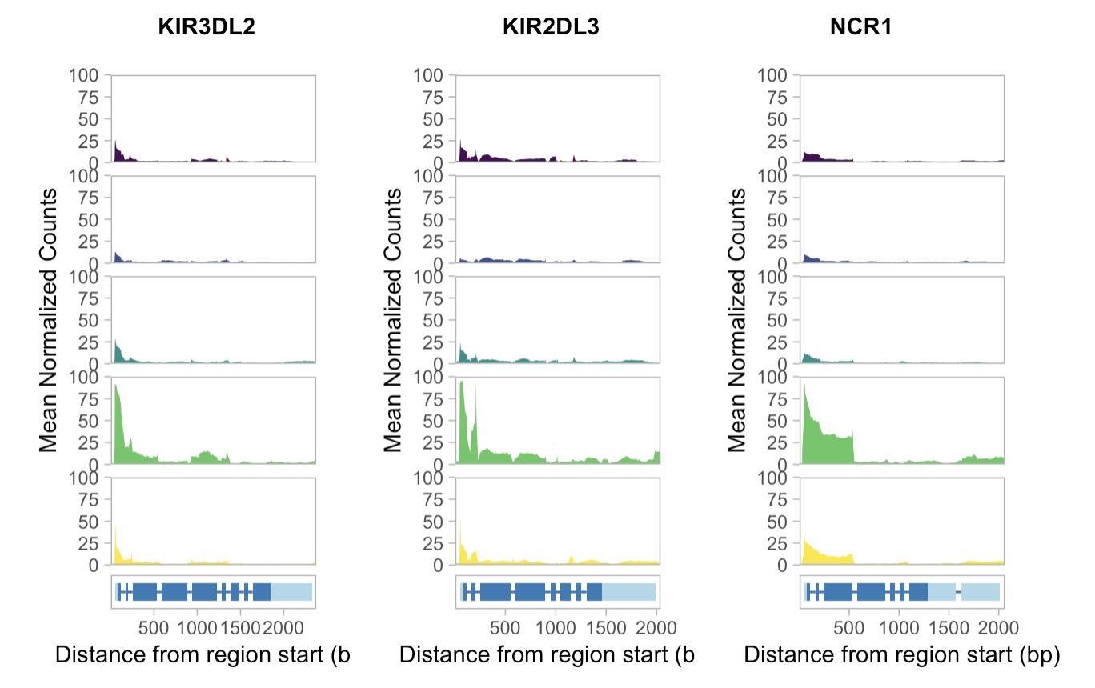
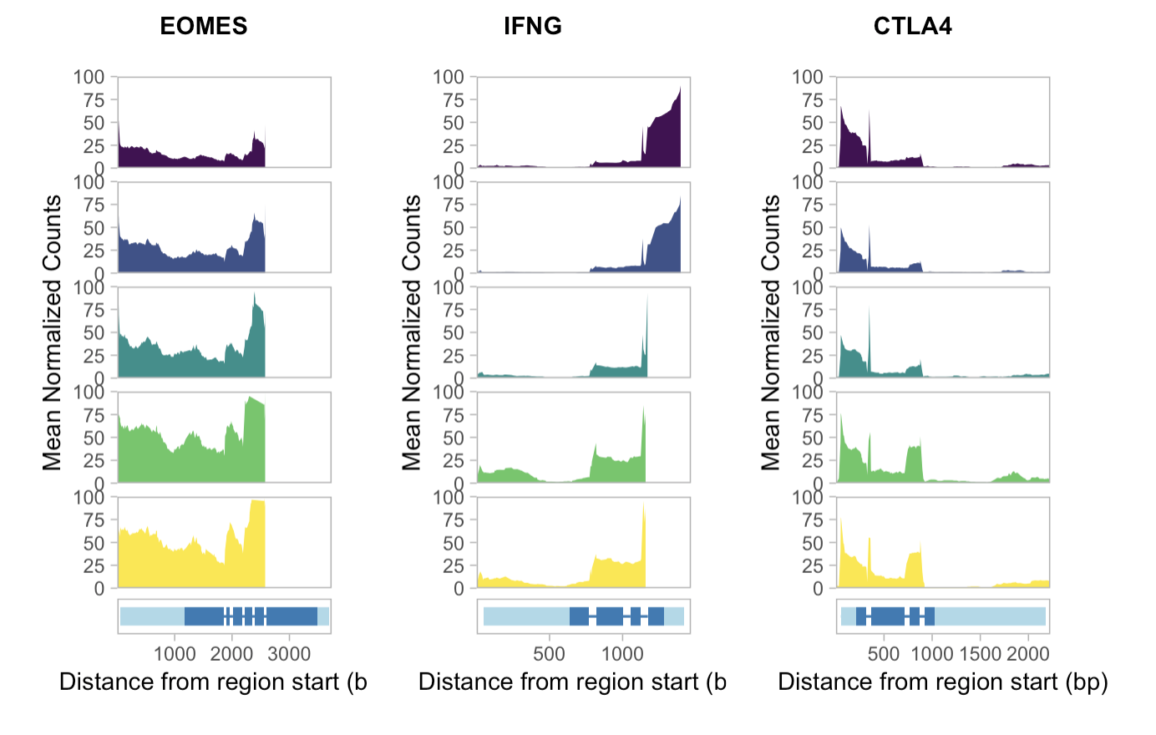
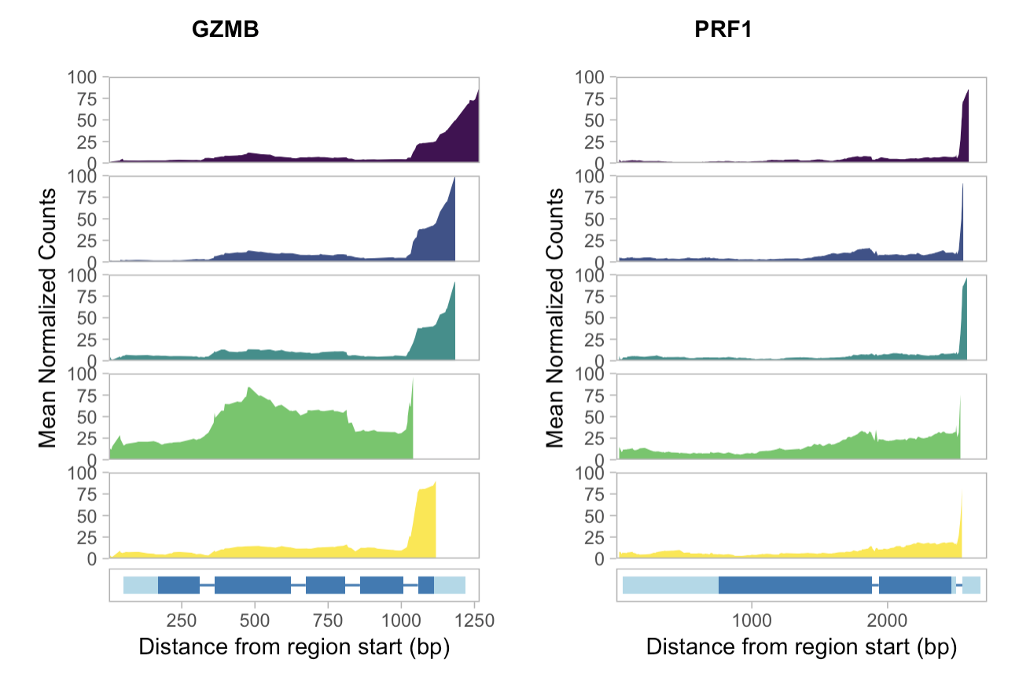
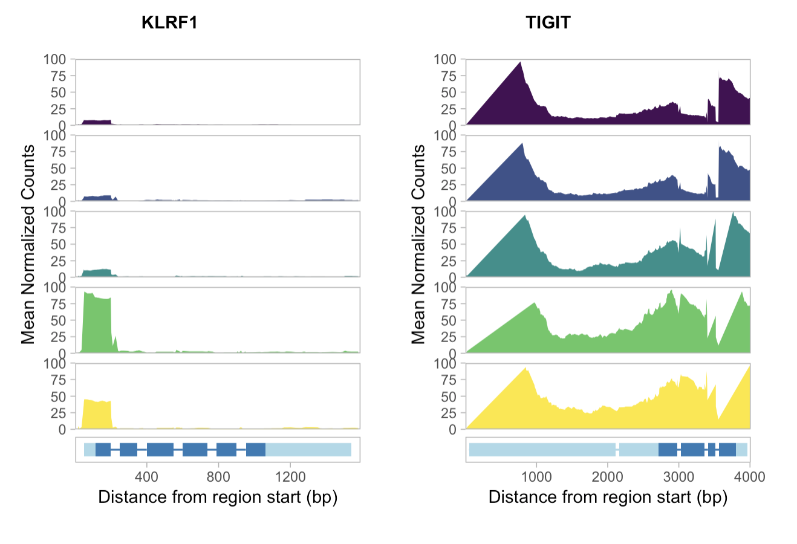
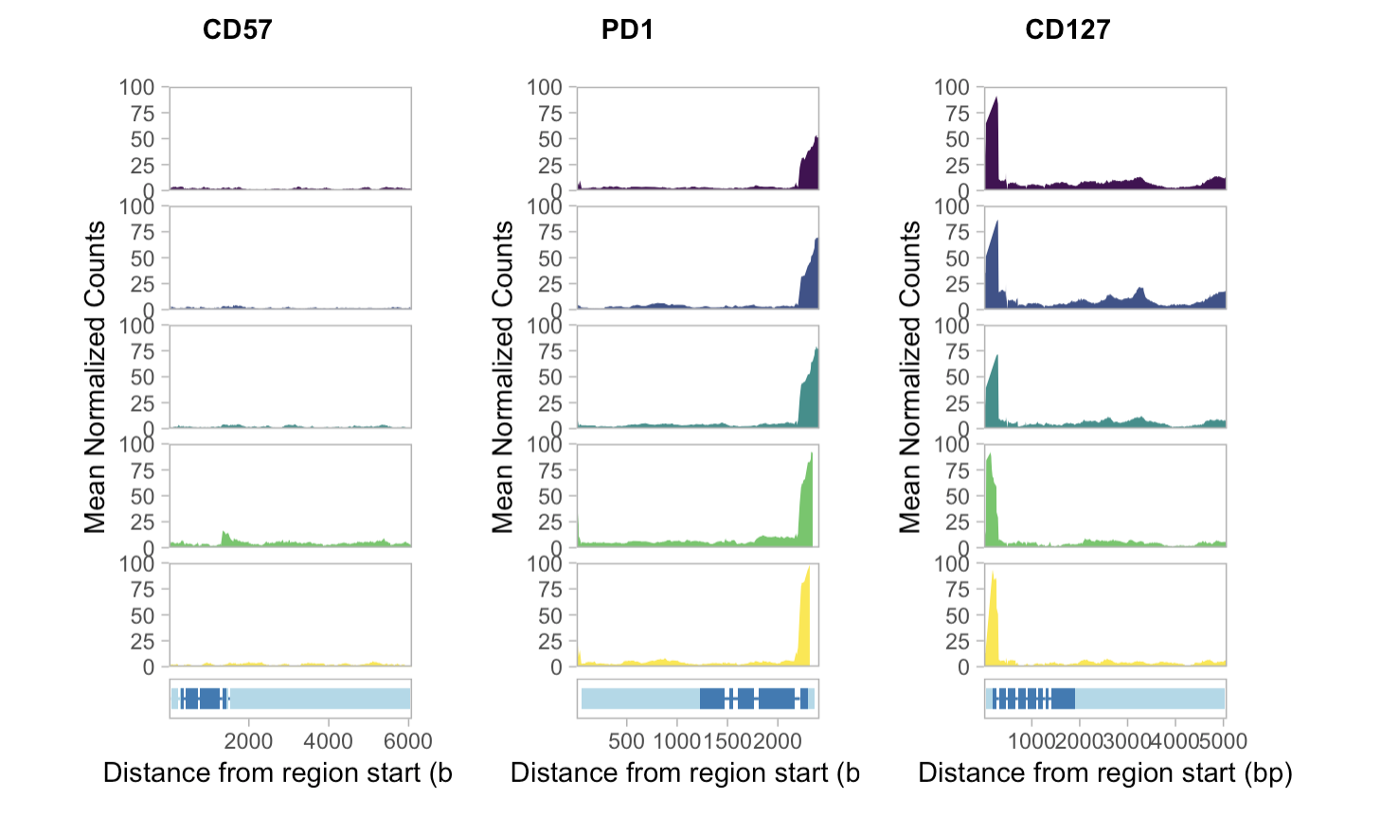
Mean coverage plots

Slide 23
Homer analyses
DP vs. DP TFs?
Sharing of DPs vs. DN ~done just add expected vs. observed sims
Notes:
Generally similar to Erin’s analyses but some caveats (TCF7 up in PD-1+ vs. CD57+ strongest consistent hit)

Slide 24
Data I have but am not sure if/how to include…
PPIs: have a few in backup slides but not sure if worth including… DP vs. DN I think current VPs are sufficient, DP vs. DP maybe it’s interesting but not sure of any interpretations
KEGG enrichment: computationally not sure why I only get activated vs. down as well, also not really sure how helpful these are…

Slide 25
Analysis that would be great to do if possible
Heatmap of genes/promoters’ accessibilities by cell pop
Promoter code ready (Stephan heatmap code right after VPs), just need to update for genes
Then run on posit grouped design to be able to get across all cell pops

Slide 26
Conclusions
Responders and non-responders to teplizumab have similar epigenetic profiles in non-naïve CD8s
Different cell populations have different epigenetic profiles
Epigenetic profiles of DP PD-1⁺ and DP CD57⁺ appear similar between this and Erin’s P452 T1DAL projects

Slide 27
Discussion
Perhaps having TIGIT⁺KLRG1⁺ cell sort to compare to DP subpopulations would be beneficial for differentiation path model testing, not sure if we can distinguish between differentiation path models with this data…

Slide 28
Next steps
Infer meaning from KEGG enrichment analyses
PPIs also from peaks’ closest promoters
Make heatmaps of genes’/promoters’ accessibility by cell population
Investigate variability between donors in mean coverage plots and Homer analyses
Compare Homer results pre/post- downsampling Erin’s P452 read counts to levels similar here in P576 (i.e. should we sequence P576 to a greater depth to get better powered Homer results?)

Slide 29

Acknowledgements
Peter Linsley
Long lab
Alice Long
Alice Wiedeman
Josh Centore
Bioinformatics group
Erin Witkop
Stephan Pribitzer
Basilin Benson

Slide 30
Extra slides

Slide 31
DP T_{ex} populations are heterogeneous, overlapping
Notes:
CyTOF data I think

Slide 32
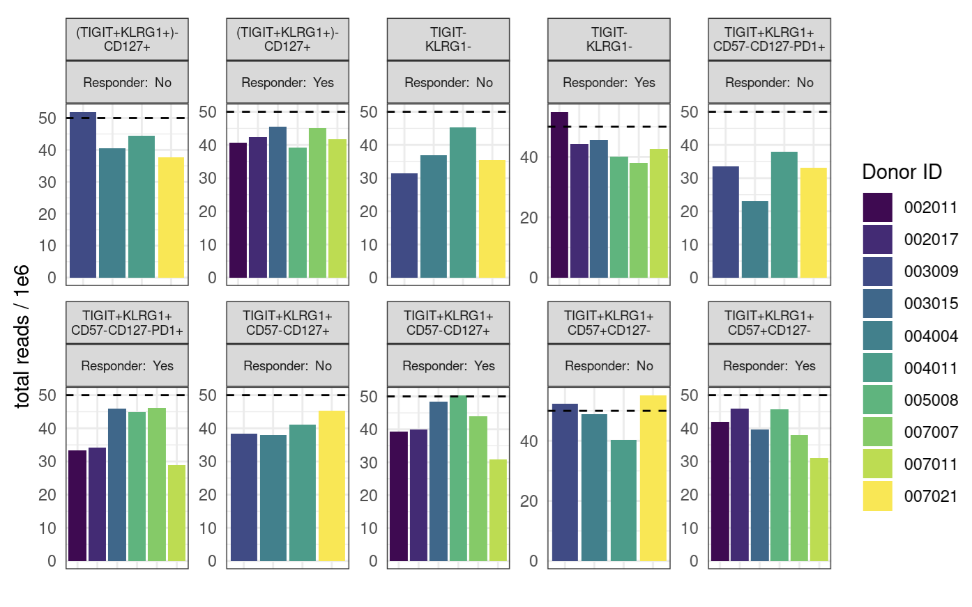
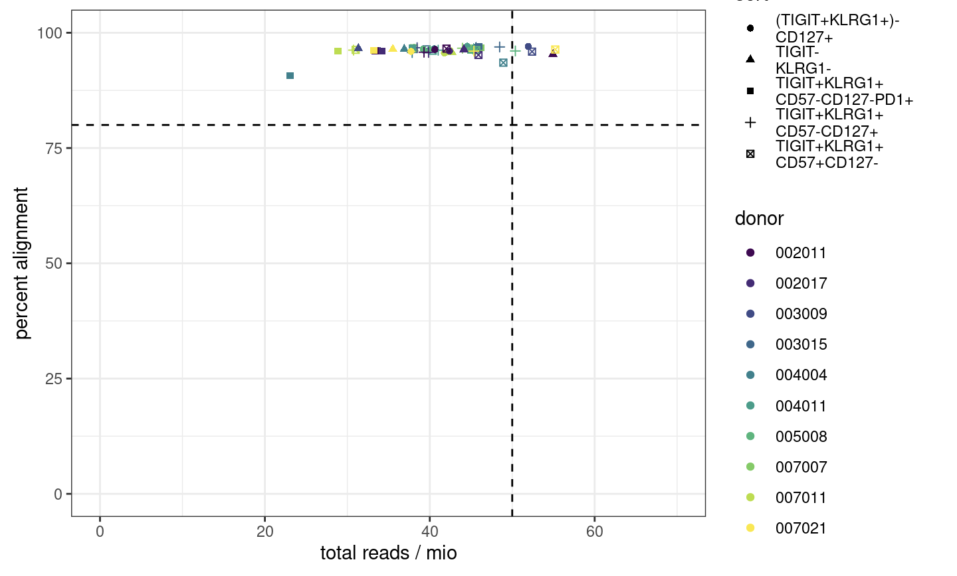
Few libraries have desired 50 million reads, alignment passes
Notes:
ENCODE recommends 50 mio (aligned) reads for paired-end, 25 mio for single read
ENCODE: each replicate should have 25 million non-duplicate, non-mitochondrial aligned reads for single-end sequencing and 50 million for paired-ended sequencing (i.e. 25 million fragments, regardless of sequencing run type). The alignment rate, or percentage of mapped reads, should be greater than 95%, though values > 80% may be acceptable
want 10-50 mil reads depending on if TF analysis required (ENCODE suggestions)
we now want our samples to fall into the top right corner
consequences: may have reduced sensitivity (for low abundance/rare stuff), increased noise, decreased reproducibility across replicates (i.e. within sort+responder groups)
P452 may have had more reads/library because less libraries for the flowcell… Vivian expected P576-1 reads average around 50M but they were on average lower…

Slide 33
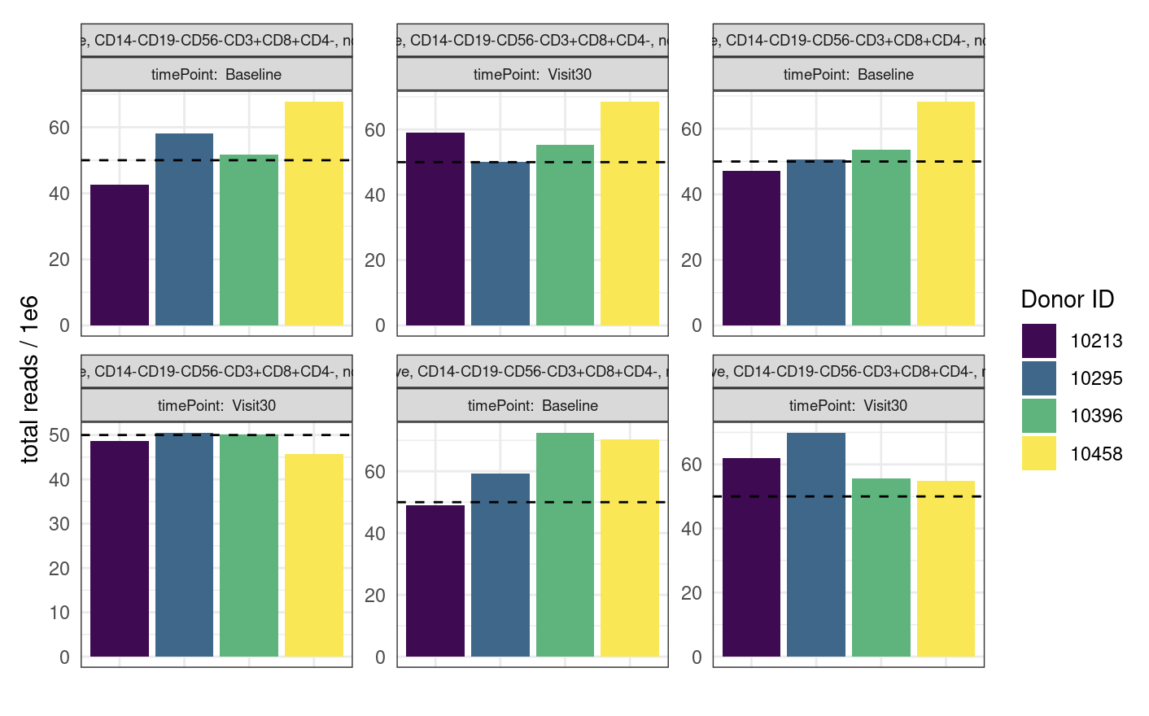
P452 QC comparable to that of P576-1 but does have more reads

Slide 34
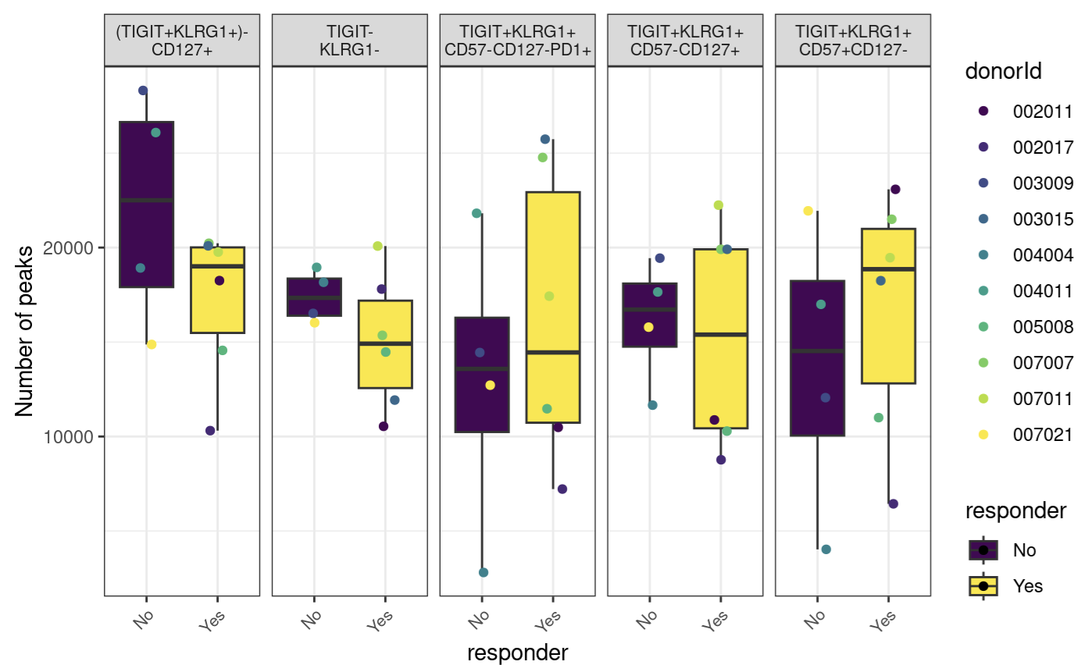
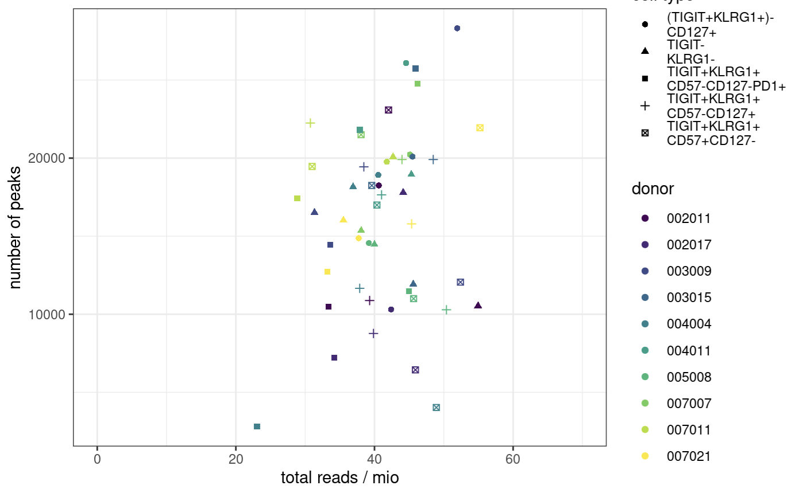
Peak counts
Notes:
ENCODE:The number of peaks within a replicated peak file should be >150,000, though values >100,000 may be acceptable.
ENCODE recommends > 150,000 peaks, although > 100,000 is still acceptable

Slide 35
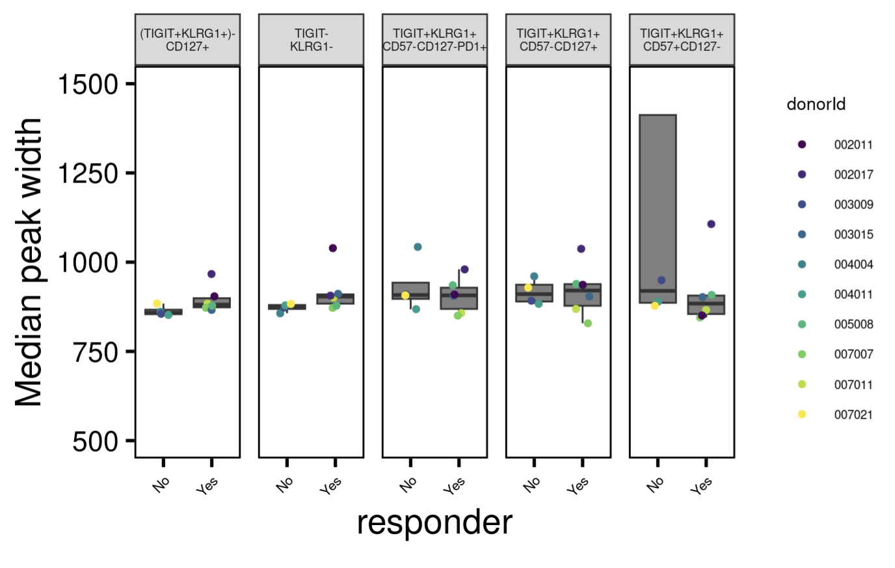
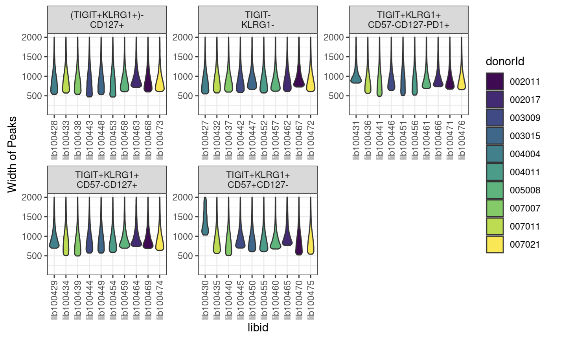
Peak widths
Notes:
want ~400-1000 bp peak widths as medians
libid100430 is wide peak one

Slide 36
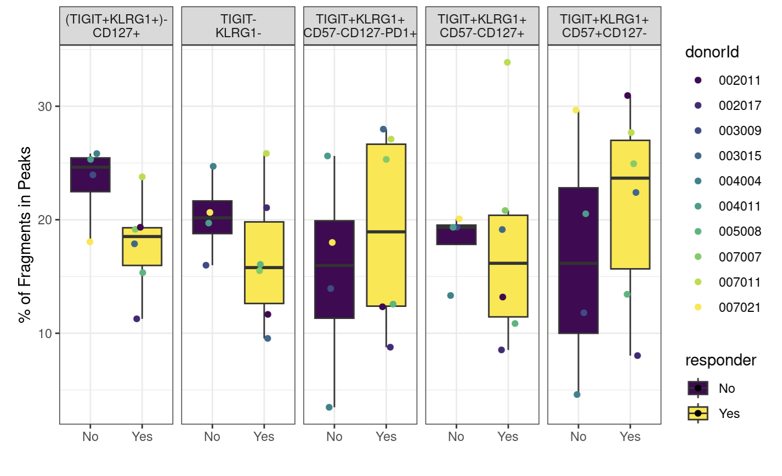
Fraction of reads in peaks
Notes:
ENCODE: The fraction of reads in called peak regions (FRiP score) should be > 0.3, though values greater than 0.2 are acceptable. TSS enrichment remains in place as a key signal to noise measure
FRiP is calculated by going through the bam files and counting the reads that fall within a called peak

Slide 37
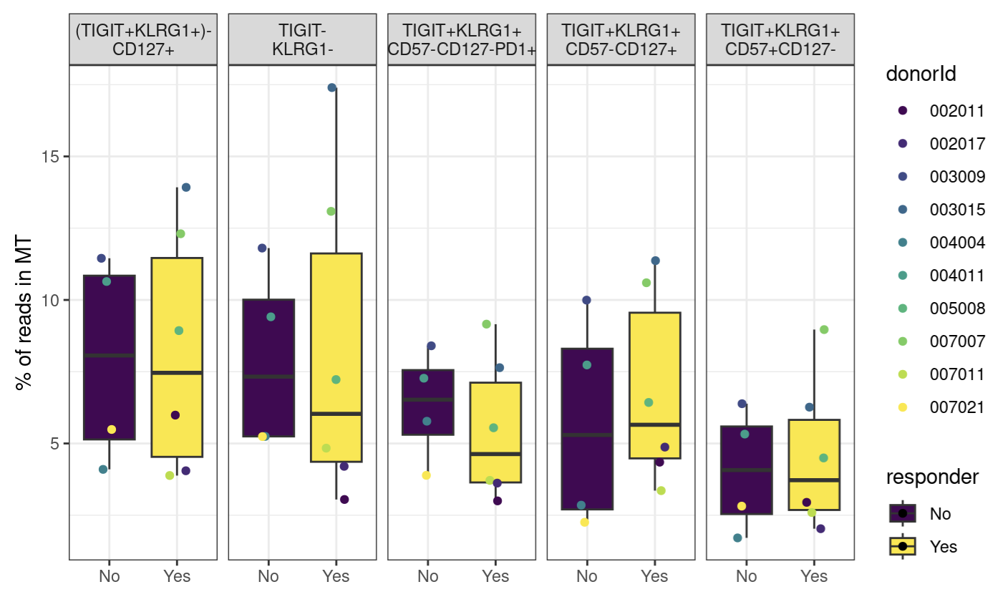
Percent of reads mapping to mitochondrial genome

Slide 38
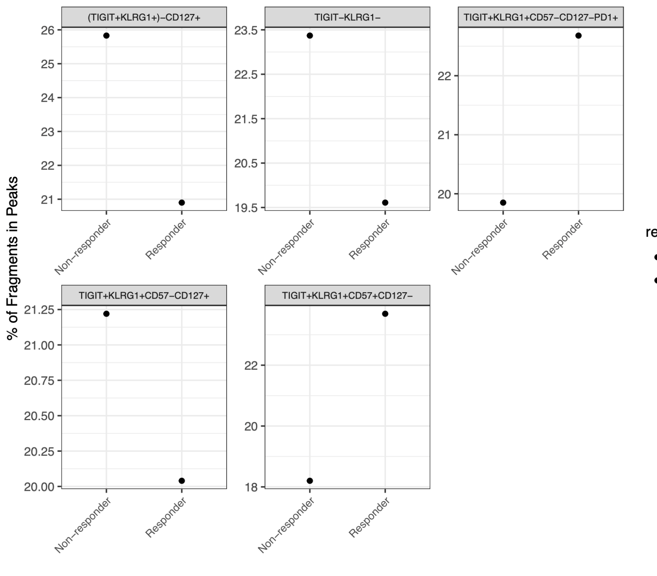
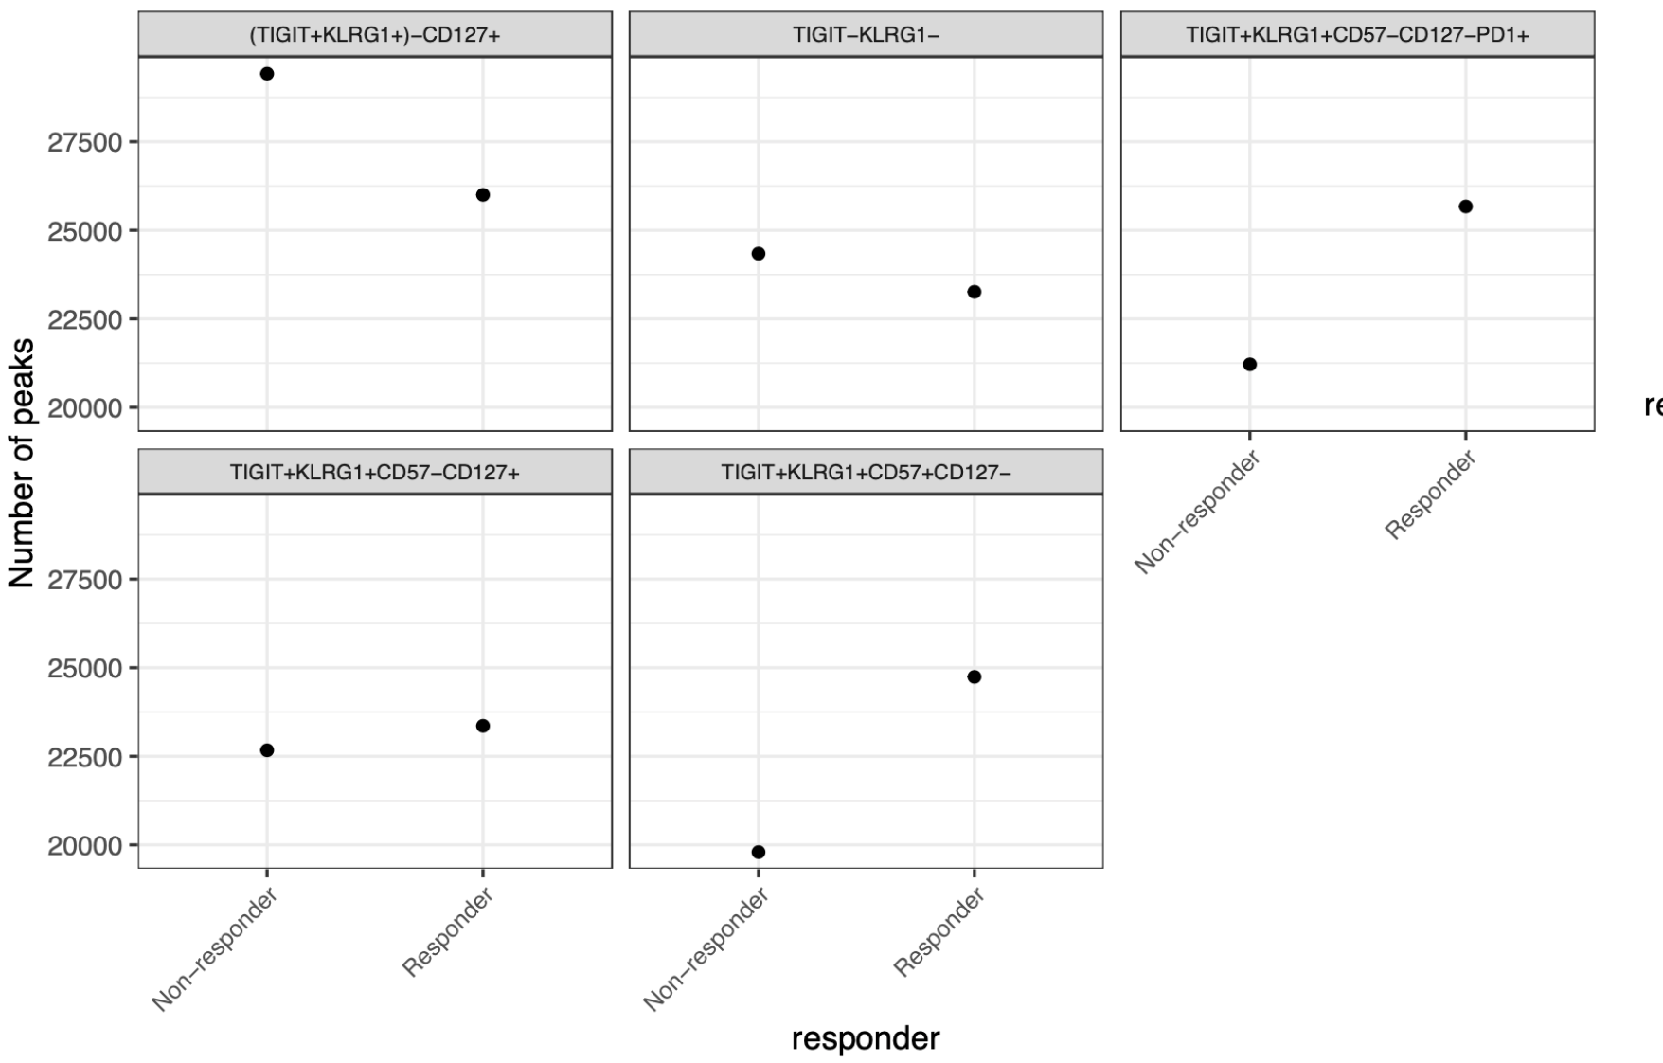
As expected, FRiPs are higher after merging alignment and peak files; peak counts are still lower than expected (still similar to P452)
Notes:
Merging:
Old Erin way: make the consensus peak set using peaks identified in at least two samples
New Stephan way: merged peaks from peaks called on merged alignment files by study group?

Slide 39
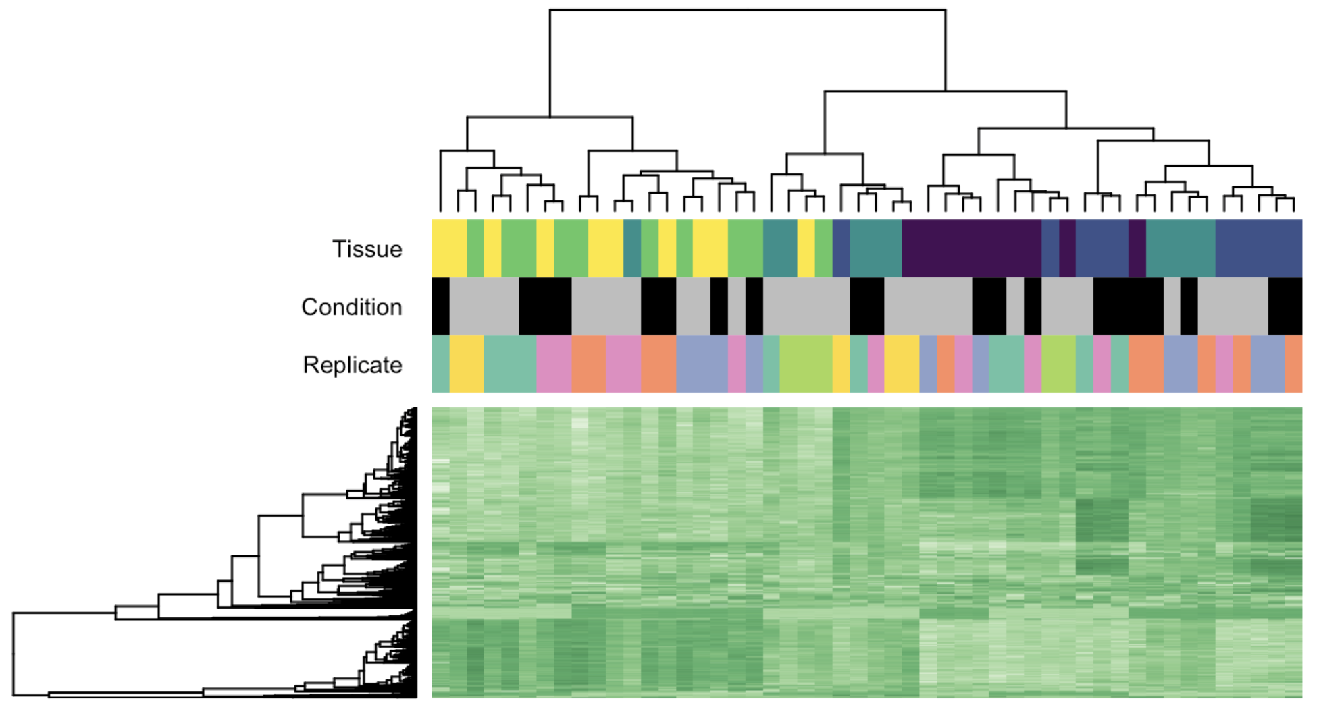
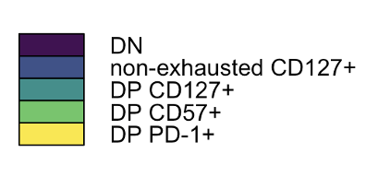
Cell population, rather than responder status, drives epigenetic differences
Why do I see instances
Of same donor
Being both R and NR??
Some kind of plotting issue
I believe…
Cell population
Cell population
Responder status
Donor
Responder status
Non-responder
Responder

Slide 40
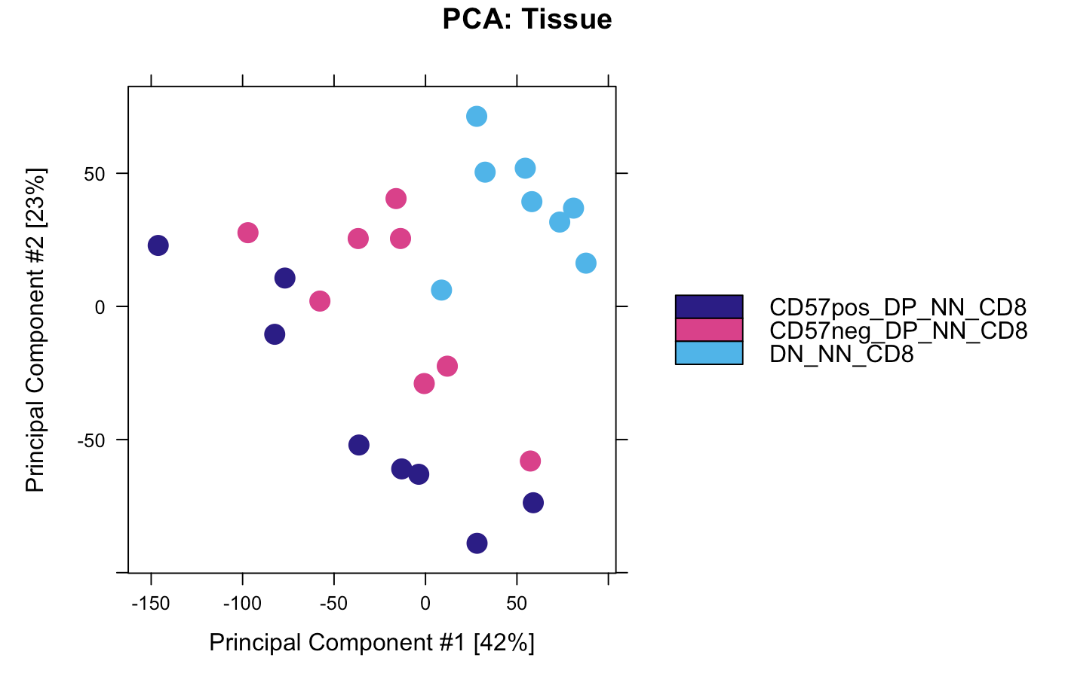
DP CD57⁺ and DP PD-1⁺ also cluster away from DN in P452, DP PD-1⁺ being more intermediate
Notes:
CyTOF data I think

Slide 41
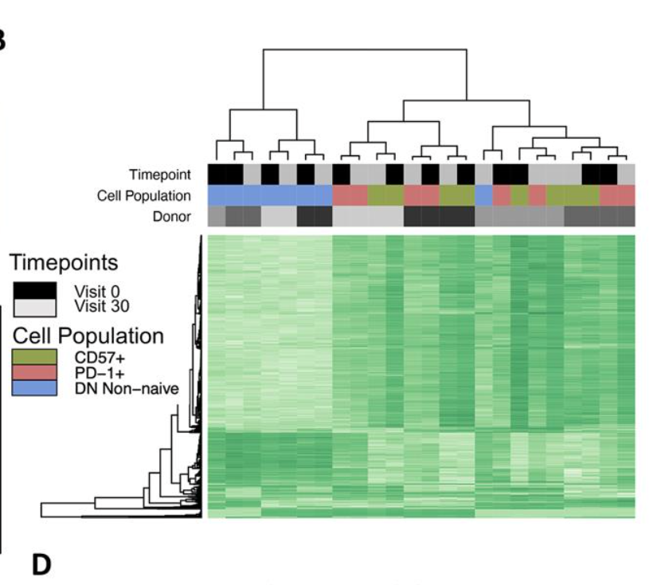
DP CD57⁺ and DP PD-1⁺ also cluster together away from DN in P452, timepoint does not drive clustering here

Slide 42
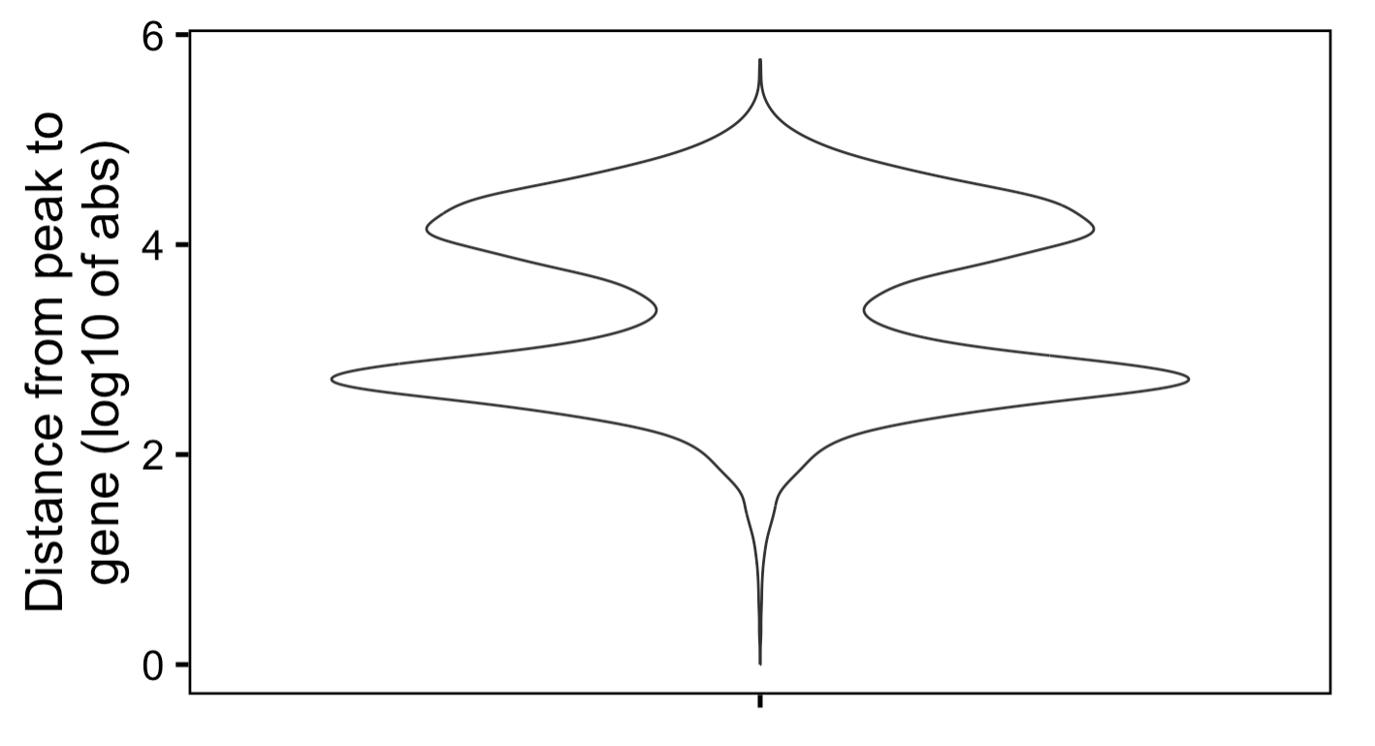
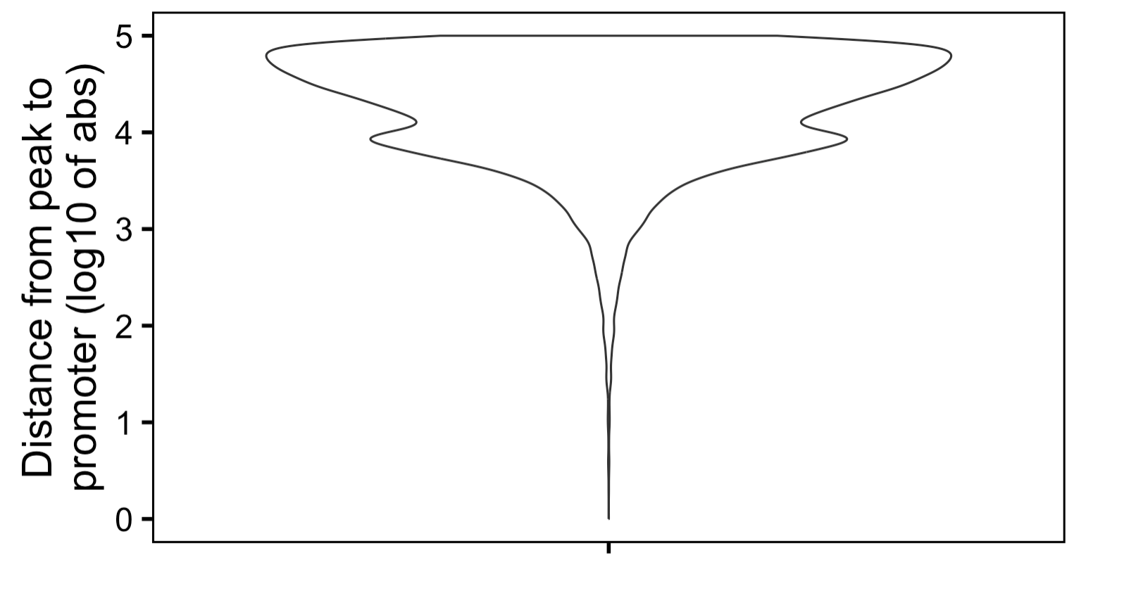
Most peaks are far away from genes (> 5 kb) and promoters (> 10 kb)
Notes:
This is from PD-1+ vs. DN contrast

Slide 43
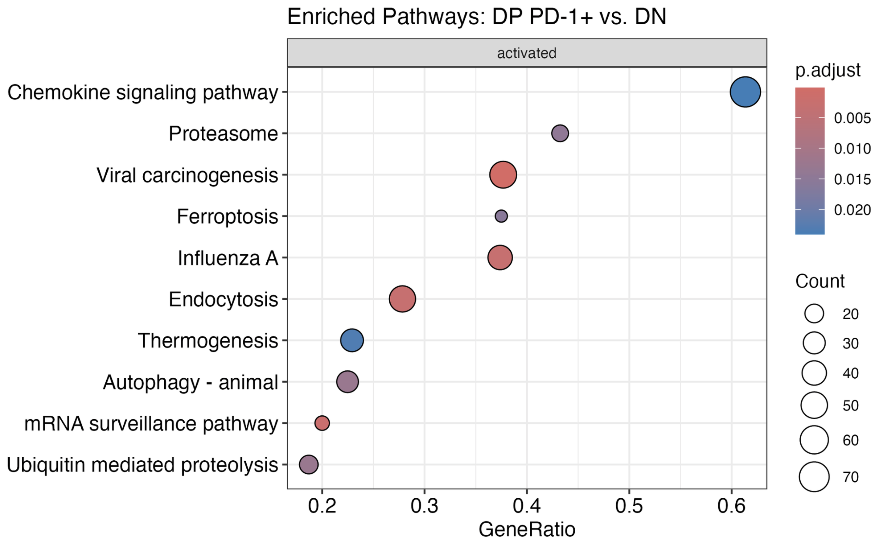
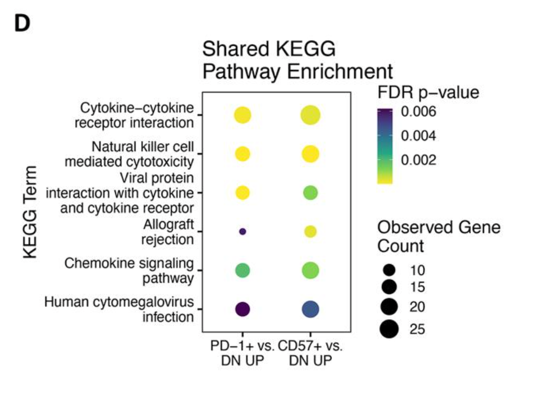
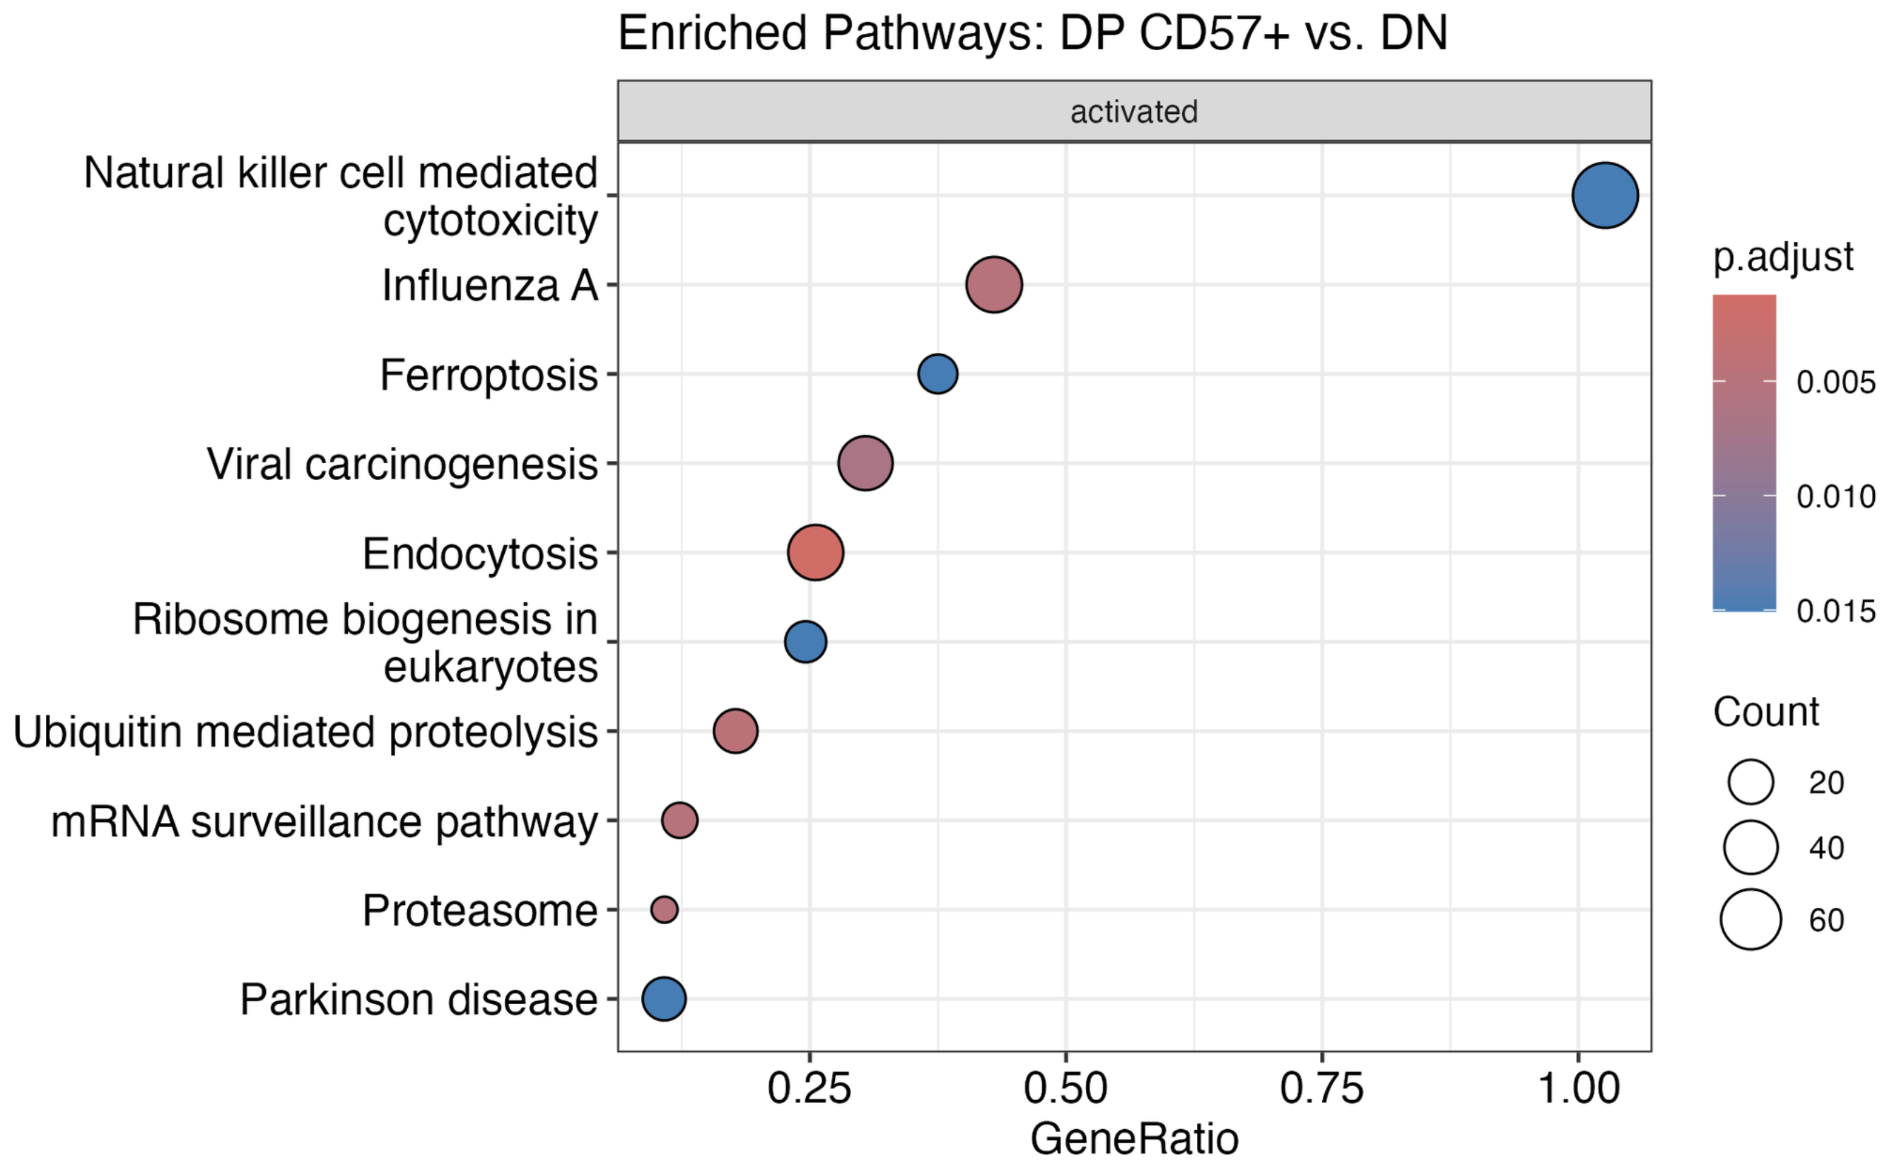
KEGG analysis not very similar between projects (methodology?)
!
!
!
!
P576
P452 (Erin’s)

Slide 44
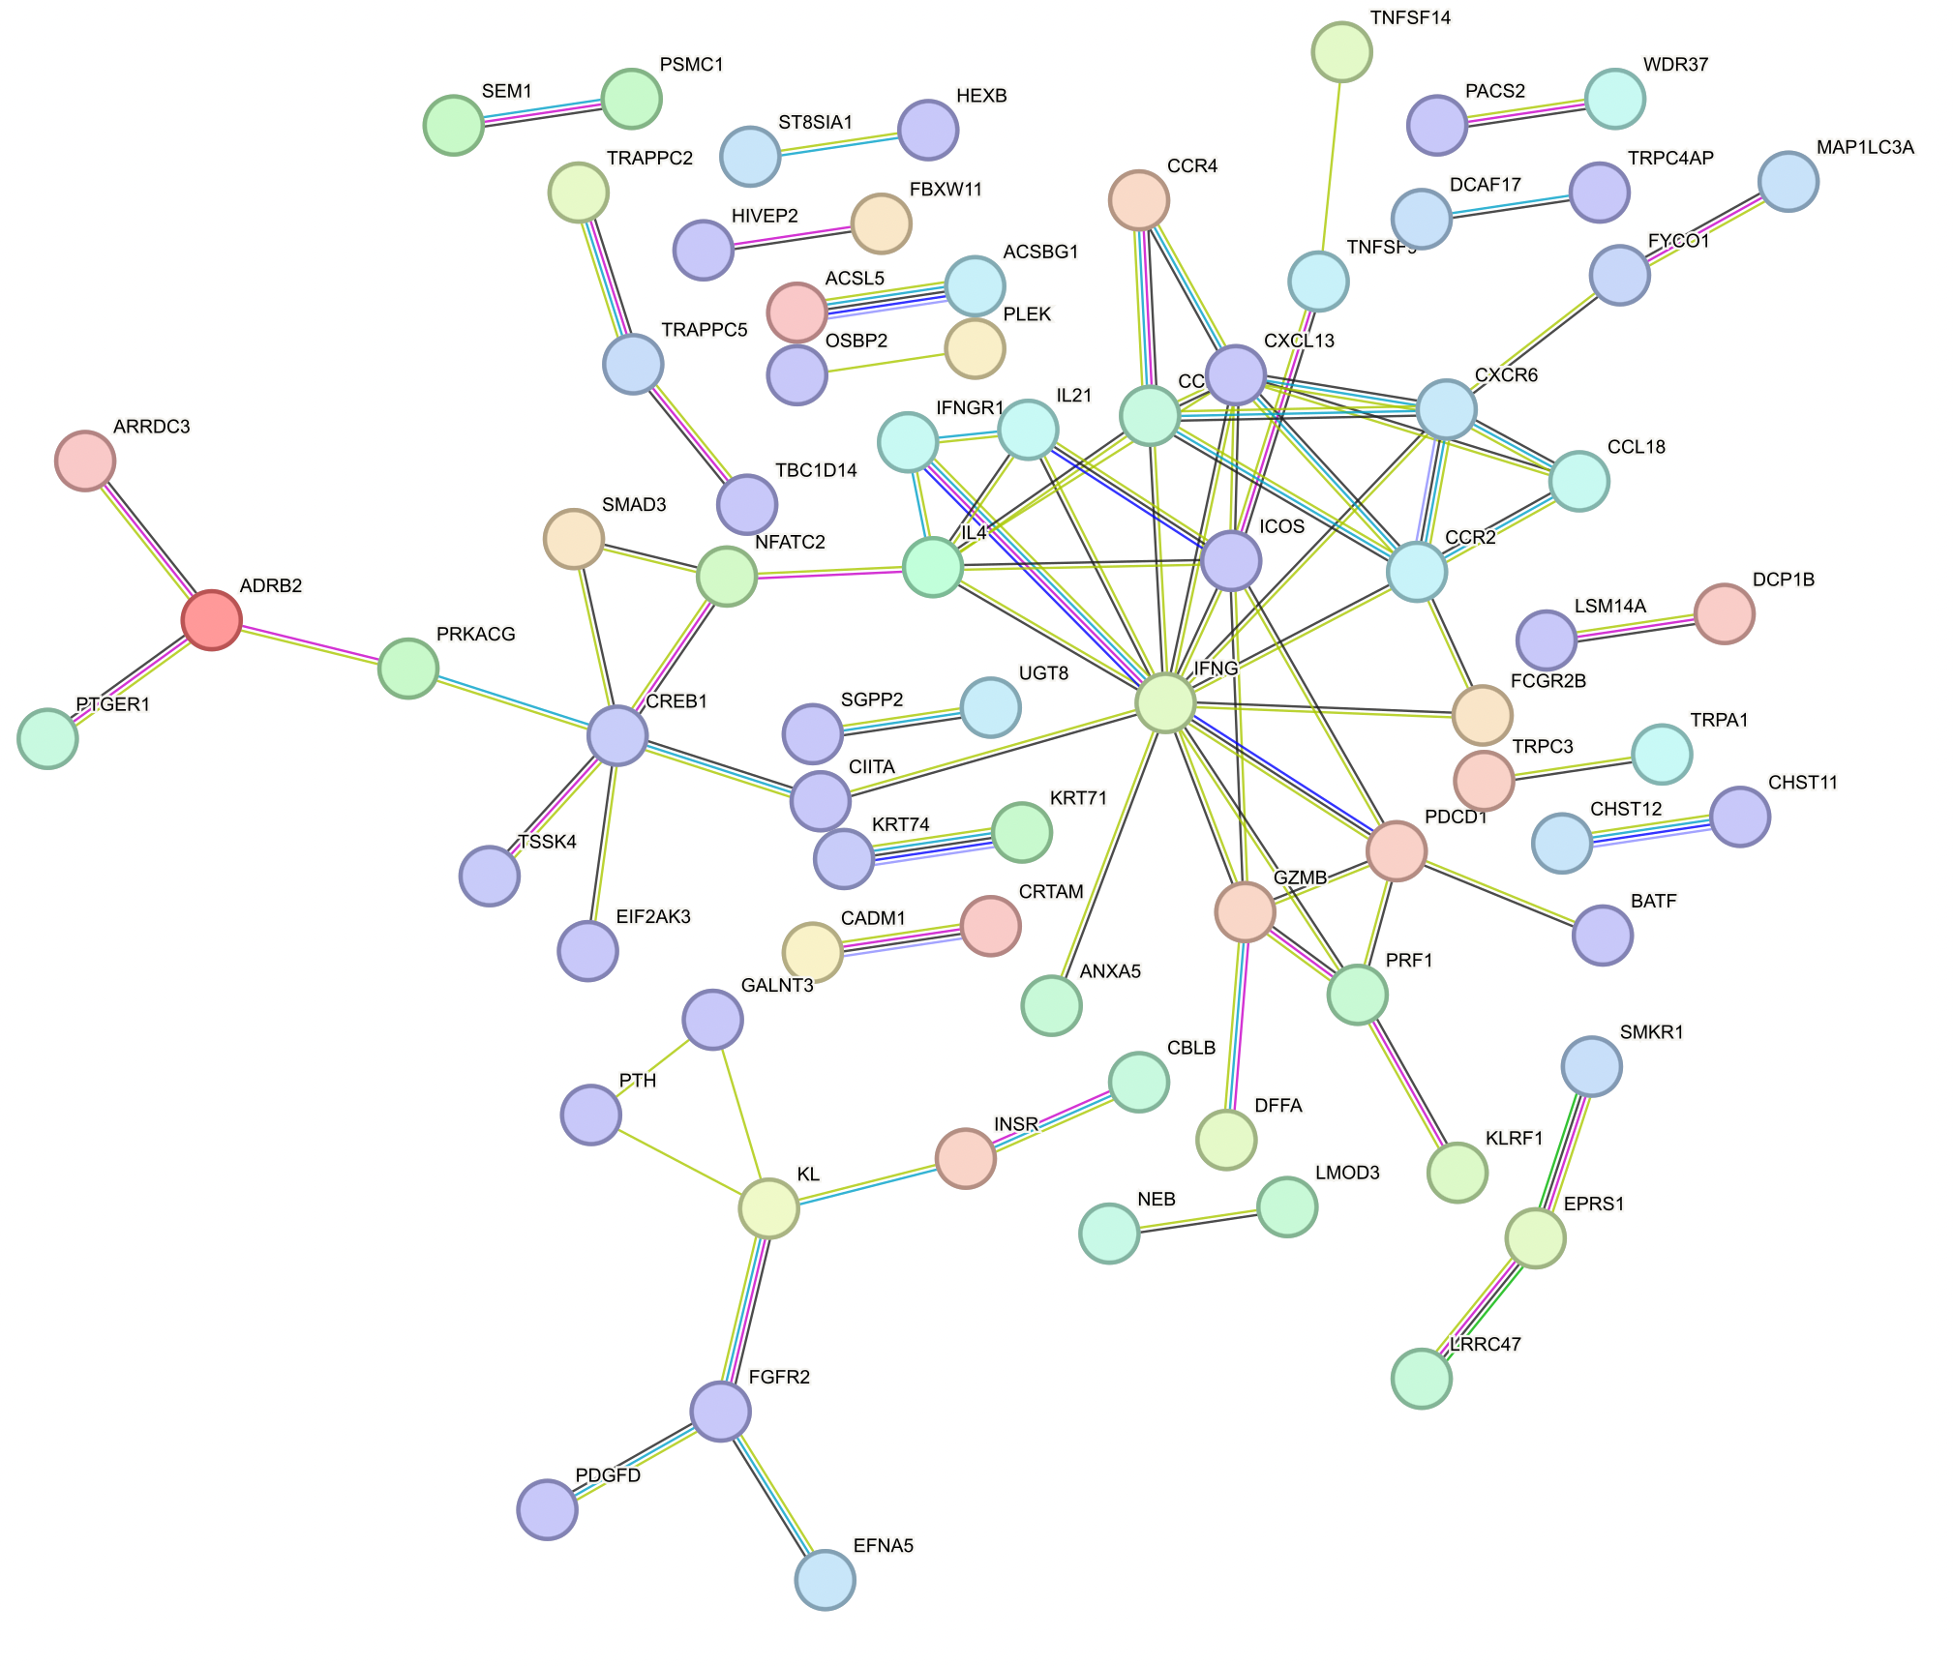
Central IFNG cluster in peaks’ genes up in DP PD-1⁺ vs. DN

Slide 45
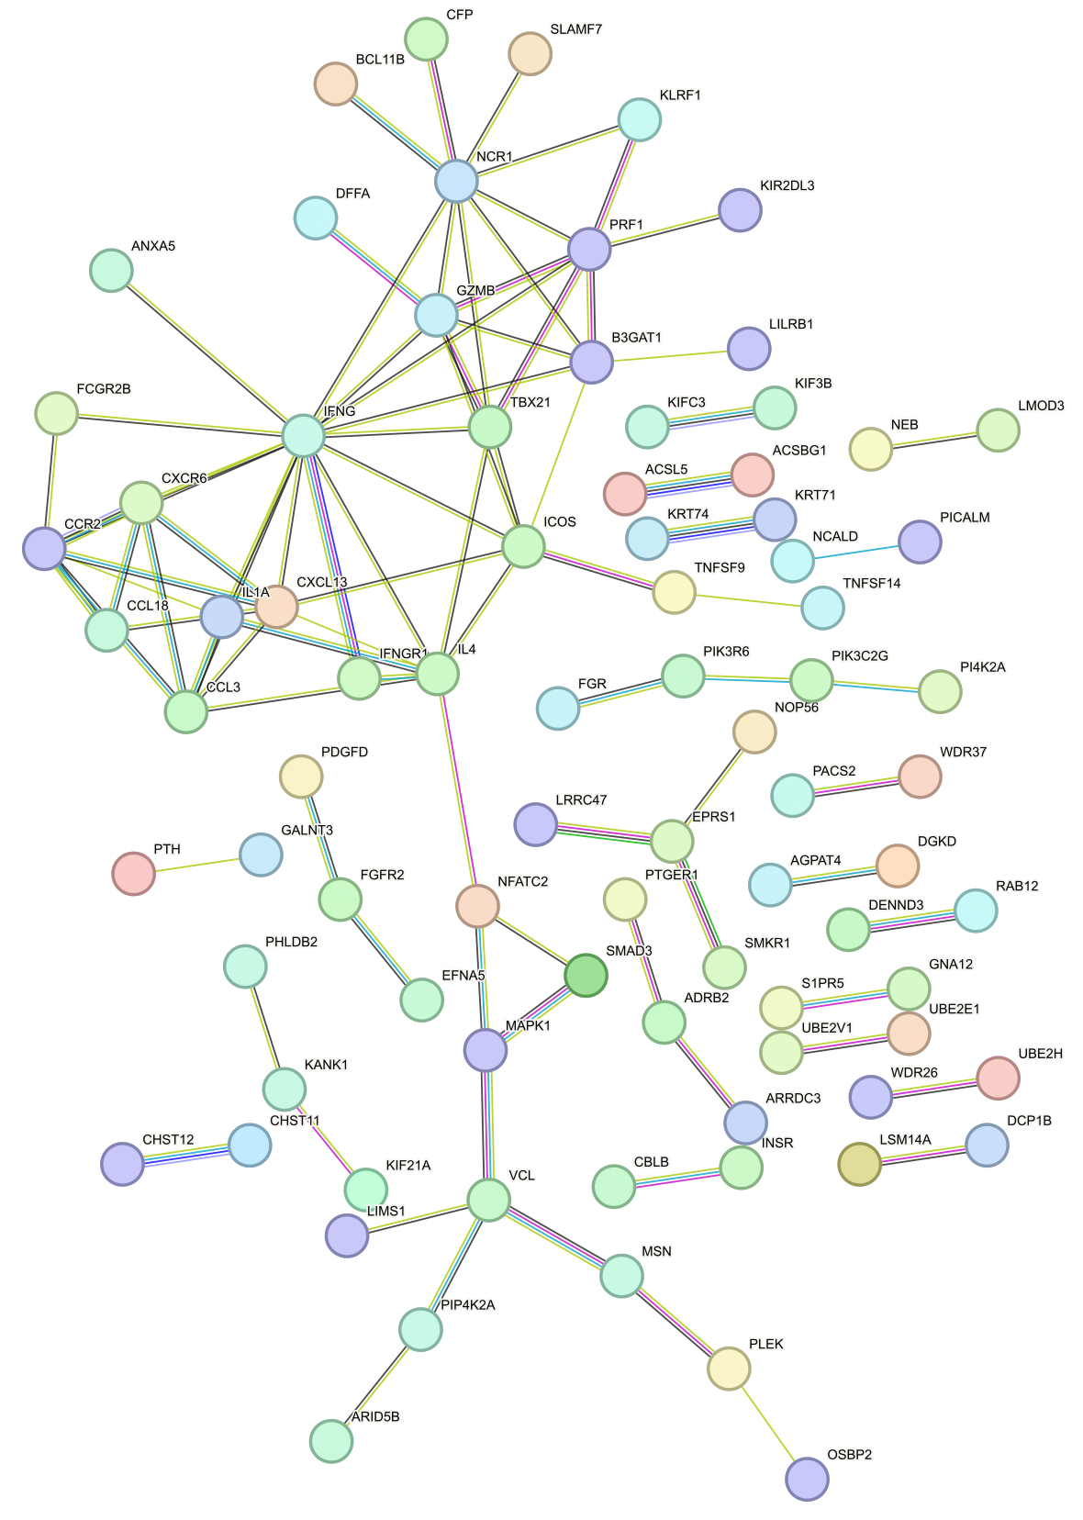
Central IFNG cluster in peaks’ genes up in DP CD57⁺ vs. DN

Slide 46
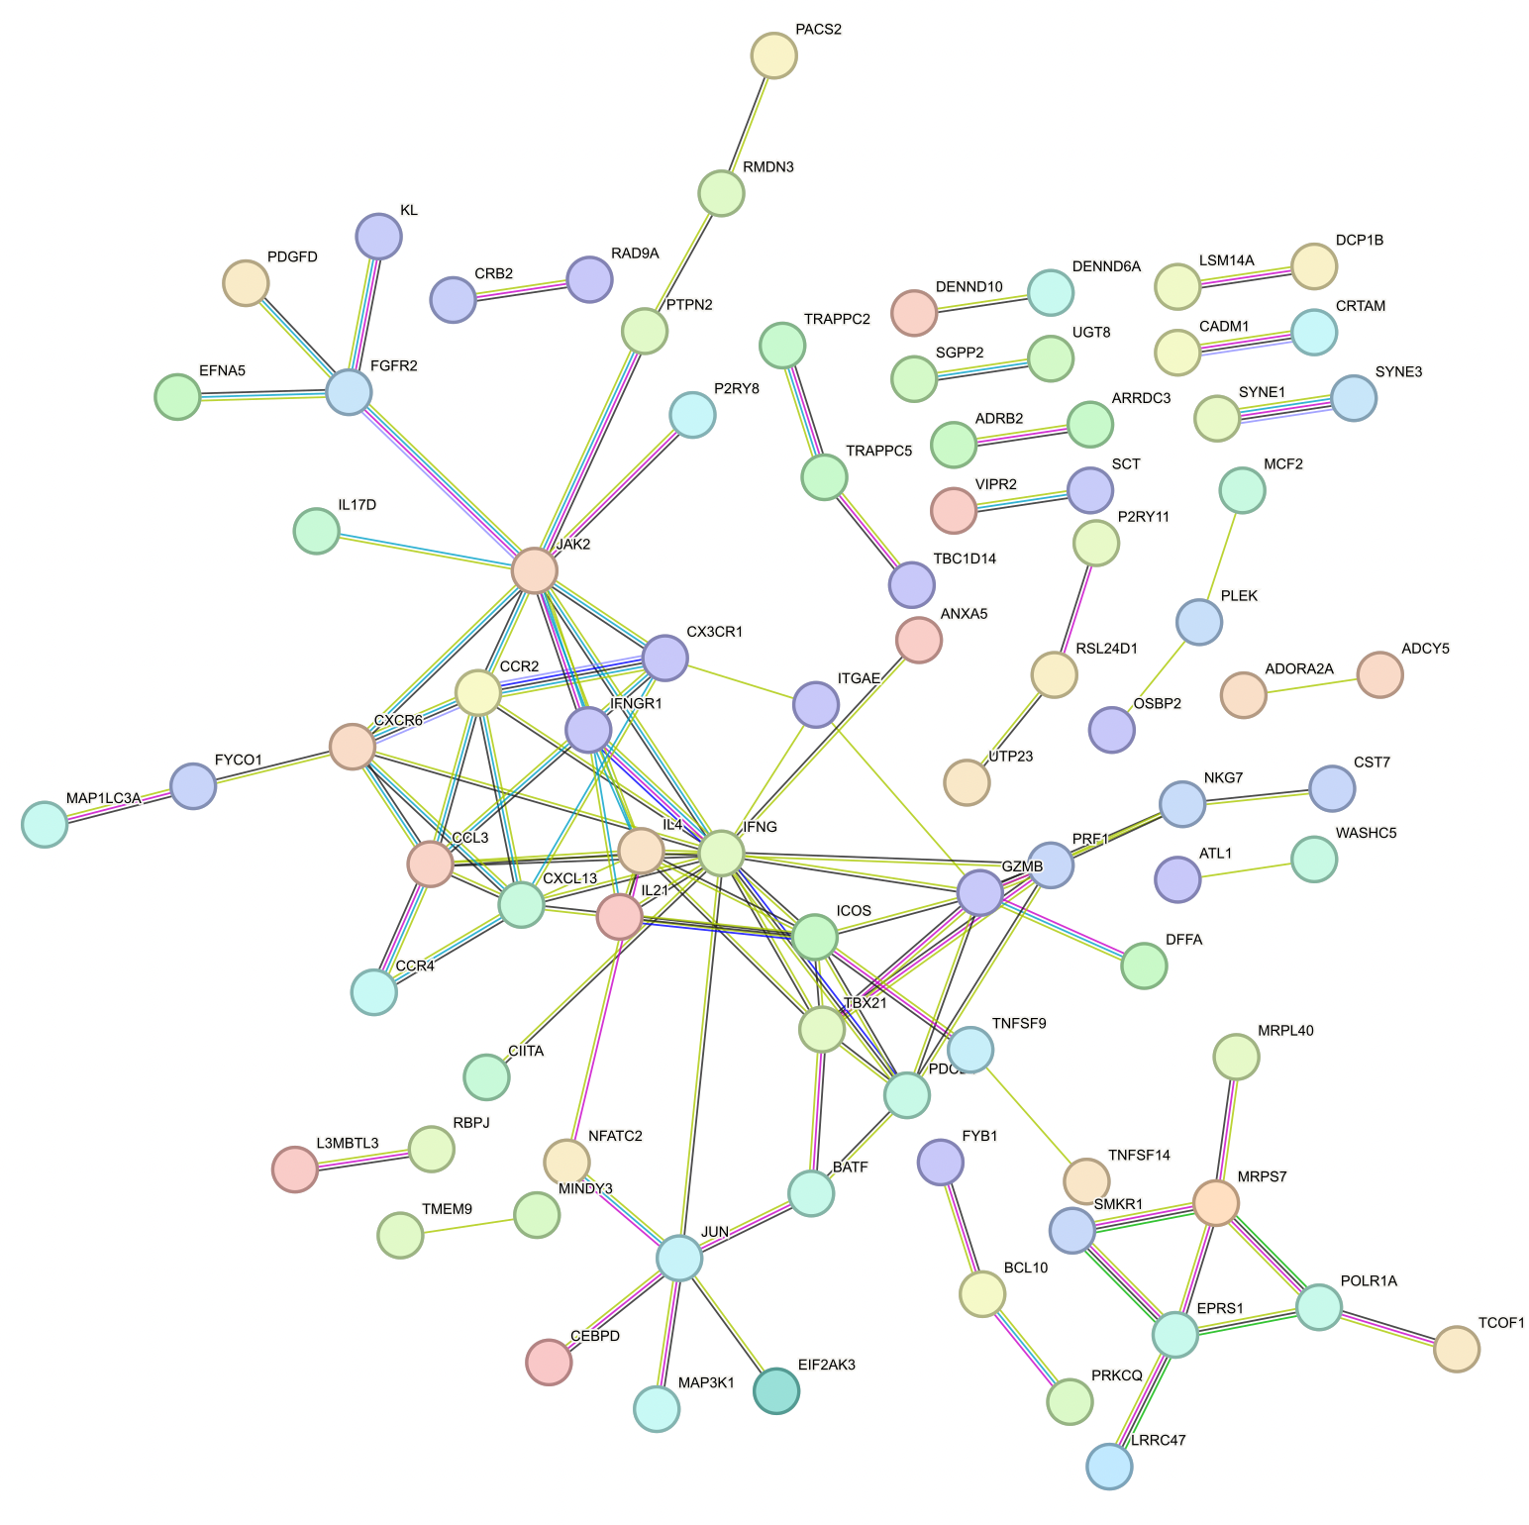
Central IFNG cluster in peaks’ genes up in DP CD127⁺ vs. DN

Slide 47
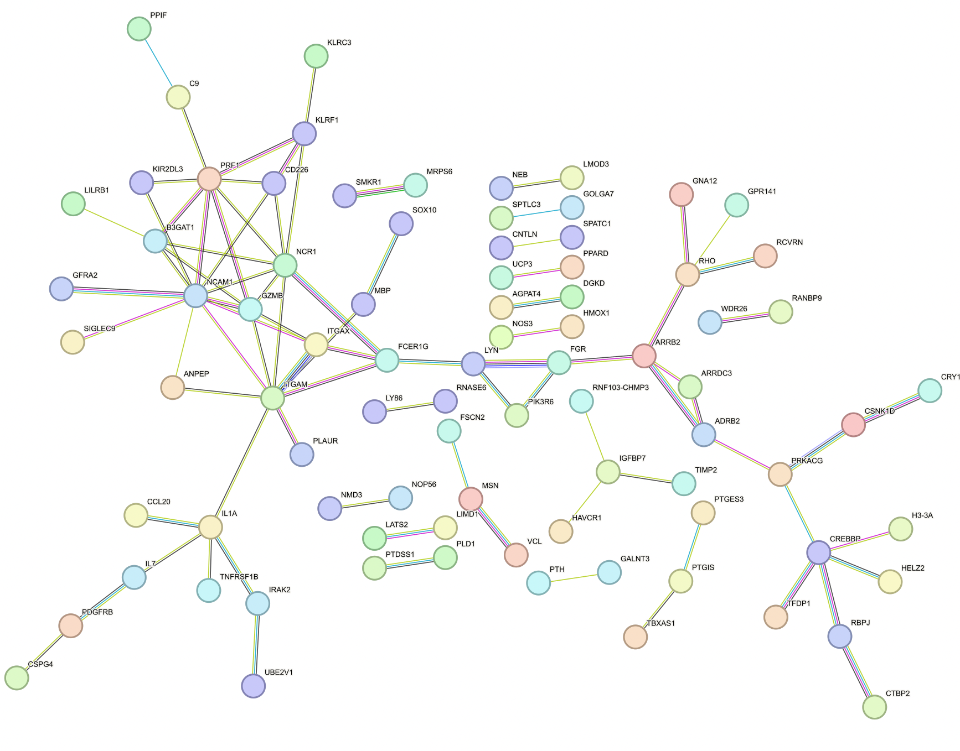
Similar PPI of peaks’ genes up in DP CD57⁺ vs. DP PD-1⁺ here as in Erin’s analyses

Slide 48

PPI of peaks’ genes up in DP PD-1⁺ vs. DP CD57⁺

